Slide 1
Toll Tax Management System Developed in PHP & MySQL

Slide 2
Introduction
Toll Tax Management System is a web based application that can provide all the information related to toll plazas and the passenger checks in and pays the amount, then he/she will be provided by a receipt. With this receipt he/she can leave the toll booth without waiting for any verification call.
The information would also cover registration of staff, toll plaza collection, toll plaza collection entry for vehicles, date wise report entry, Vehicle passes and passes reports b/w dates.

Slide 3
Objectives
This project is based on the RDBMS technology. The main objective of this project is to computerize the manual system & reduce the time consumption.
In other words we can say that our project has the following objectives:
• Make all the system computerize
• Reduce time consumption
• Reduce error scope
• All system managements are automated
• Centralized database management
• Easy operations for operator of the system
• No paper work requirement
Here we are going to see some points regarding to purpose and scope behind choosing this topic & what is the requirement of this type of the project in our day to day life.
Avoid the fuel loss.
Saving of time in collecting toll.
Avoid financial loss.

Slide 4
Features of the Application
Below listed is the broad category of the features for Toll Tax Department:
This application is to facilitate the department in maintaining the repositories of the report about the toll tax collected at a specific time period.
To provide details about contracts, contractors of Toll Tax Department
To provide Toll Tax Rates of different vehicles.

Slide 5
Project Modules
It has two modules
Admin
Staff

Slide 6
Admin Module
Dashboard: In this section admin can see all detail in brief like total number of staffs, Total number of vehicle category, Total number of pass, Total number of receipt, Total vehicle enter today’s, yesterday’s, last seven days and total vehicle pass till now in toll plaza.
Staff: In this section admin can manage staffs (add,update and delete).
Vehicle Category: In this section admin can manage vehicle category (add,update and delete).
Pass: In this section admin can manage pass(add and update).
Receipt: In this section admin can view receipt and take print of receipt which is make by staffs
Search Pass: In this section admin can search pass with the help of his/her pass id, owner name and vehicle number.
Search Receipt: In this section admin can search receipt with the help of his/her receipt id, owner name and vehicle number.
Reports of Pass: In this section admin can view how many pass has been made in particular periods, counts of pass and sales come from making pass.
Reports of receipt: In this section admin can view how much receipt has been made in particular periods, counts of receipt and sales come from making receipt.
Admin can also update his profile, change password and recover password.

Slide 7
Staff Module
Dashboard: Welcome page for staff.
Receipt: In this section staff can mange receipts (add and update).
Search: In this section admin can search receipt with the help of his/her receipt id.
Staffs can also update his profile, change password and recover password.

Slide 8
Requirement Specification
Hardware Configuration:
Client Side
Server Side
RAM | 512 MB
Hard Disk | 10GB
Processor | 1.0 GHz
RAM | 1 GB
Hard Disk | 20GB
Processor | 2.0GHz

Slide 9
Continue.....
Software Requirement:
Client Side
Server Side
Web Browser | Google Chrome or any compatible browser
Operating System | Windows or any equivalent OS
Web Server | APACHE
Server side Language | PHP5.6 or above version
Database Server | MySQL
Web Browser | Google Chrome or any compatible browser
Operating System | Windows or any equivalent OS

Slide 10
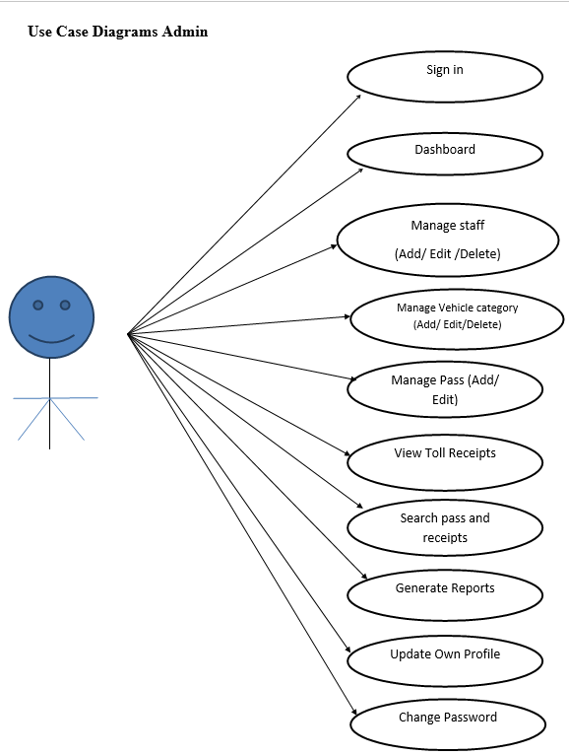
Use Case Diagram
Notes:
USECASE DIAGRAM: A Use case is a description of set of sequence of actions. Graphically it is rendered as an ellipse with solid line including only its name. Use case diagram is a behavioral diagram that shows a set of use cases and actors and their relationship. It is an association between the use cases and actors. An actor represents a real-world object. Primary Actor – Sender, Secondary Actor Receiver.

Slide 11
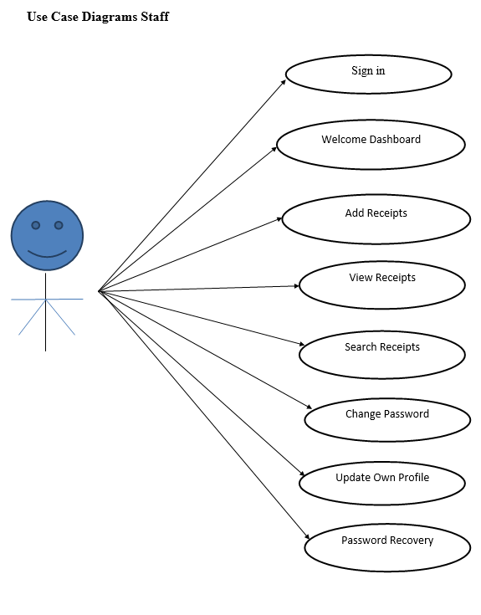

Slide 12
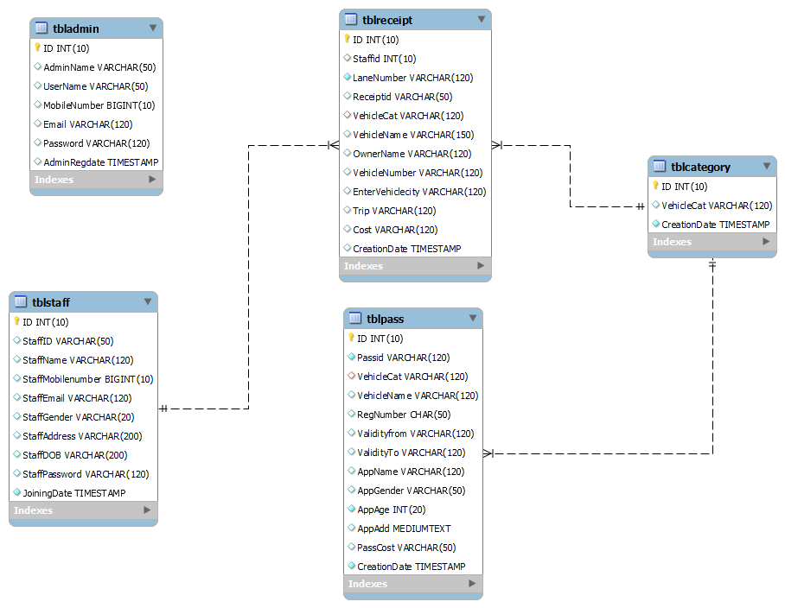
Class / Schema Diagram
Notes:
Class Diagram:
A description of set of objects that share the same attributes operations, relationships, and semantics

Slide 13
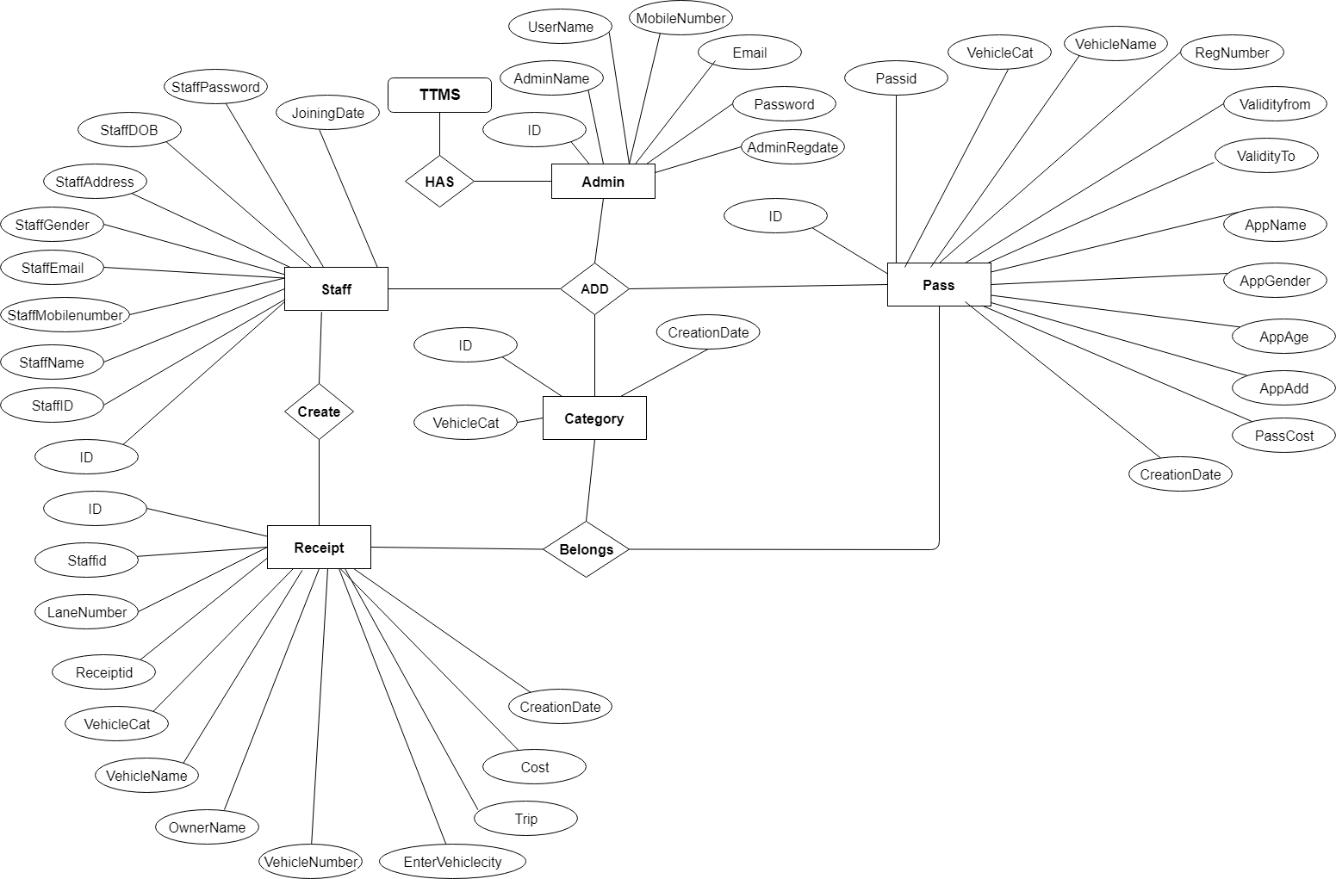
ER Diagram

Slide 14
Data Flow Diagrams (DFD)
A Data Flow Diagram (DFD) is a traditional visual representation of the information flows within a system. A neat and clear DFD can depict the right amount of the system requirement graphically. It can be manual, automated, or a combination of both.
It shows how data enters and leaves the system, what changes the information, and where data is stored.
The objective of a DFD is to show the scope and boundaries of a system as a whole. It may be used as a communication tool between a system analyst and any person who plays a part in the order that acts as a starting point for redesigning a system. The DFD is also called as a data flow graph or bubble chart.

Slide 15
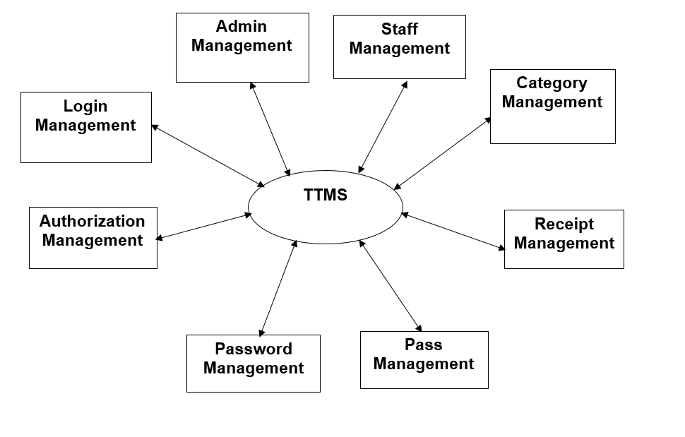
Continue…
Zero Level

Slide 16
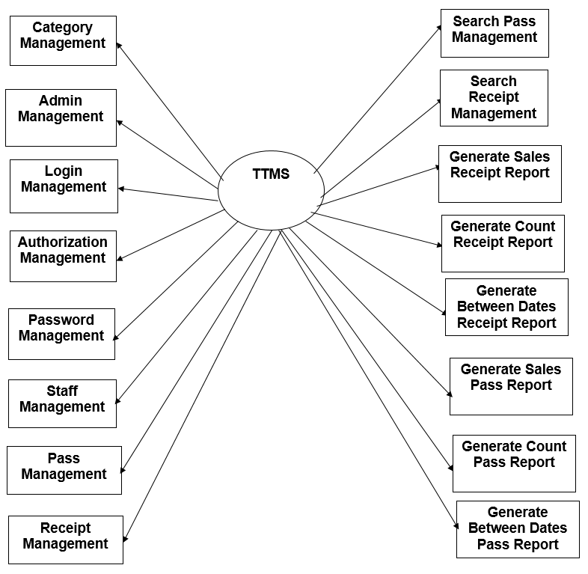
Continue….
First Level

Slide 17
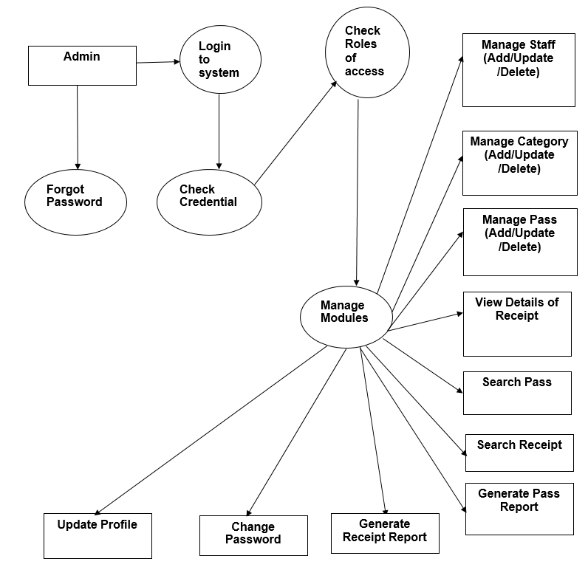
Continue….
Second Level

Slide 18
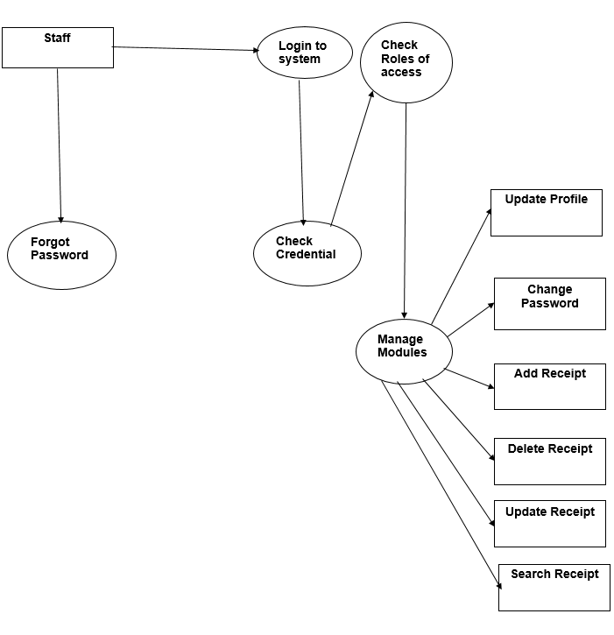
Continue….

Slide 19
Implementation and System Testing
After all phase have been perfectly done, the system will be implemented to the server and the system can be used.
System Testing
The goal of the system testing process was to determine all faults in our project .The program was subjected to a set of test inputs and many explanations were made and based on these explanations it will be decided whether the program behaves as expected or not. Our Project went through two levels of testing
Unit testing
Integration testing

Slide 20
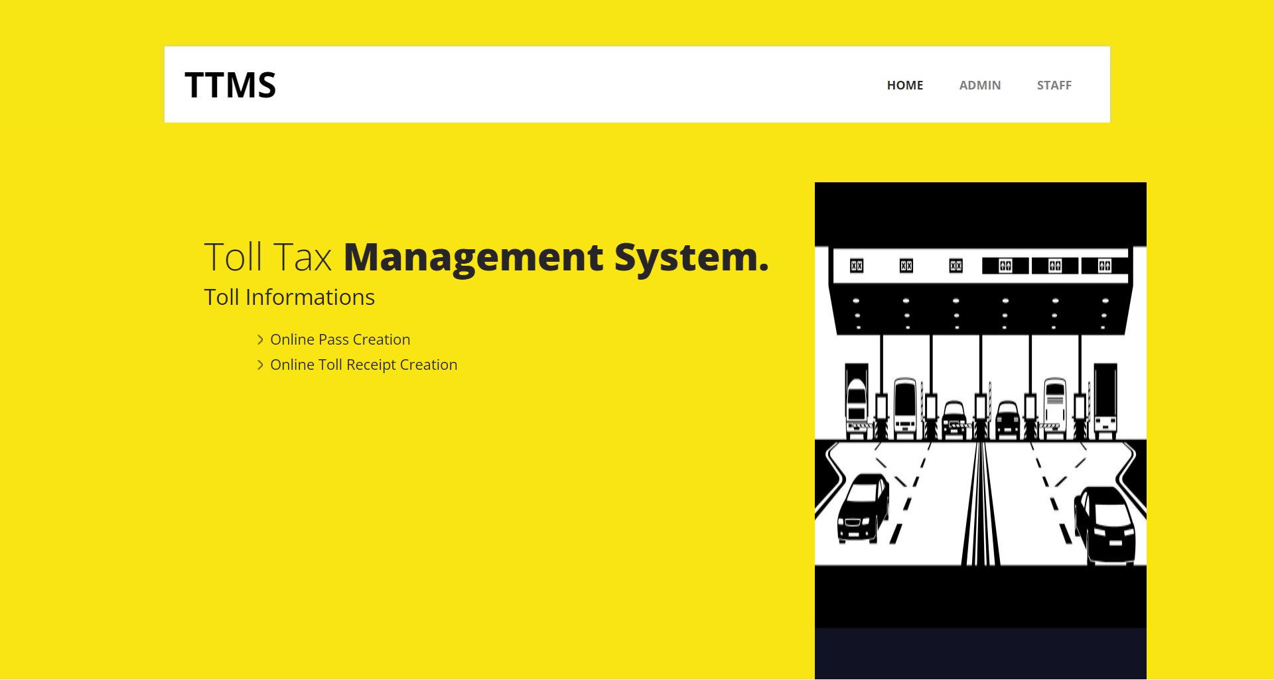
Project Screens

Slide 21
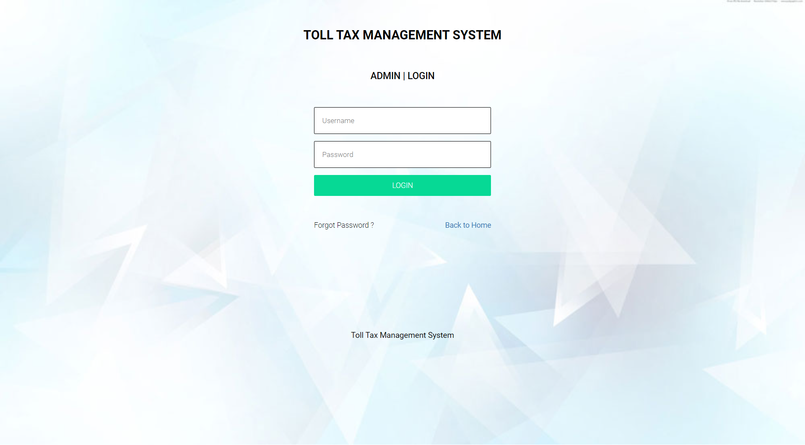


Slide 22

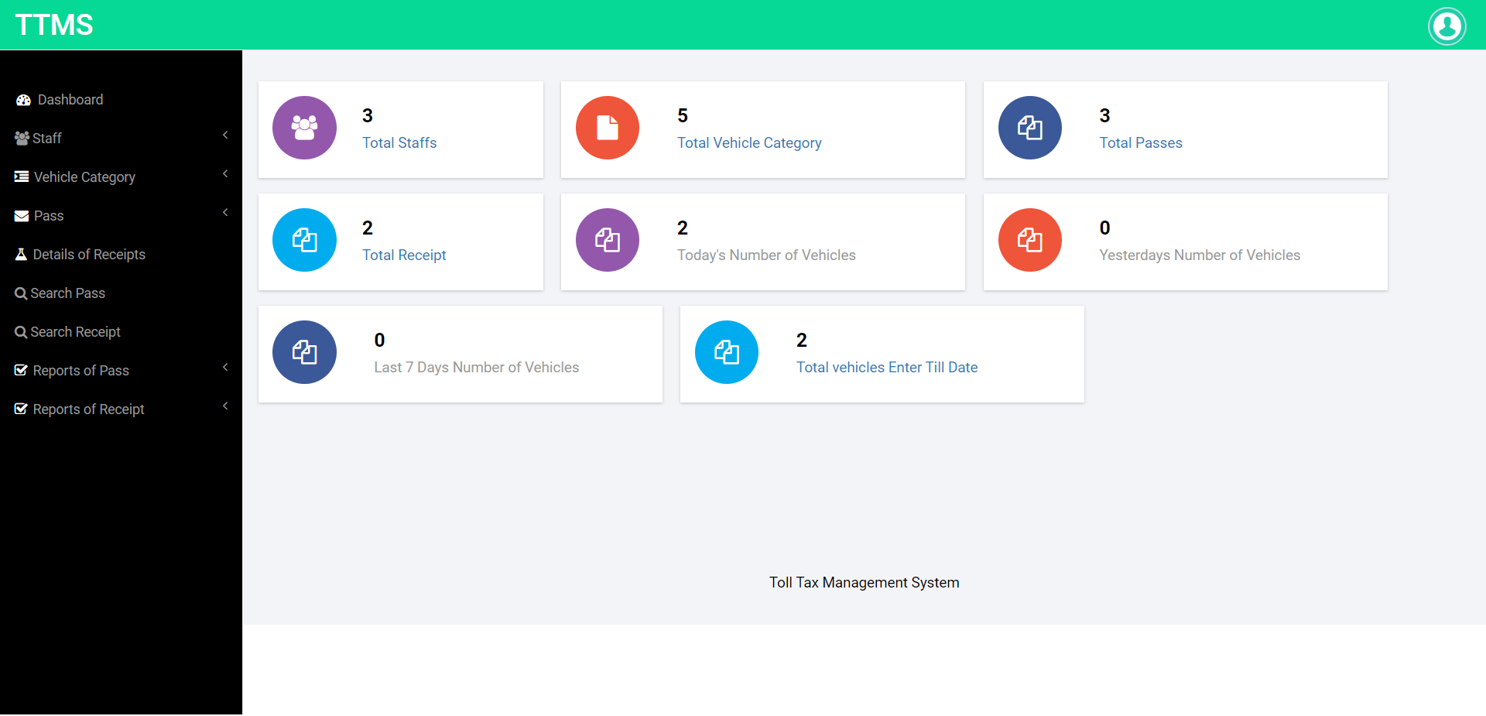

Slide 23
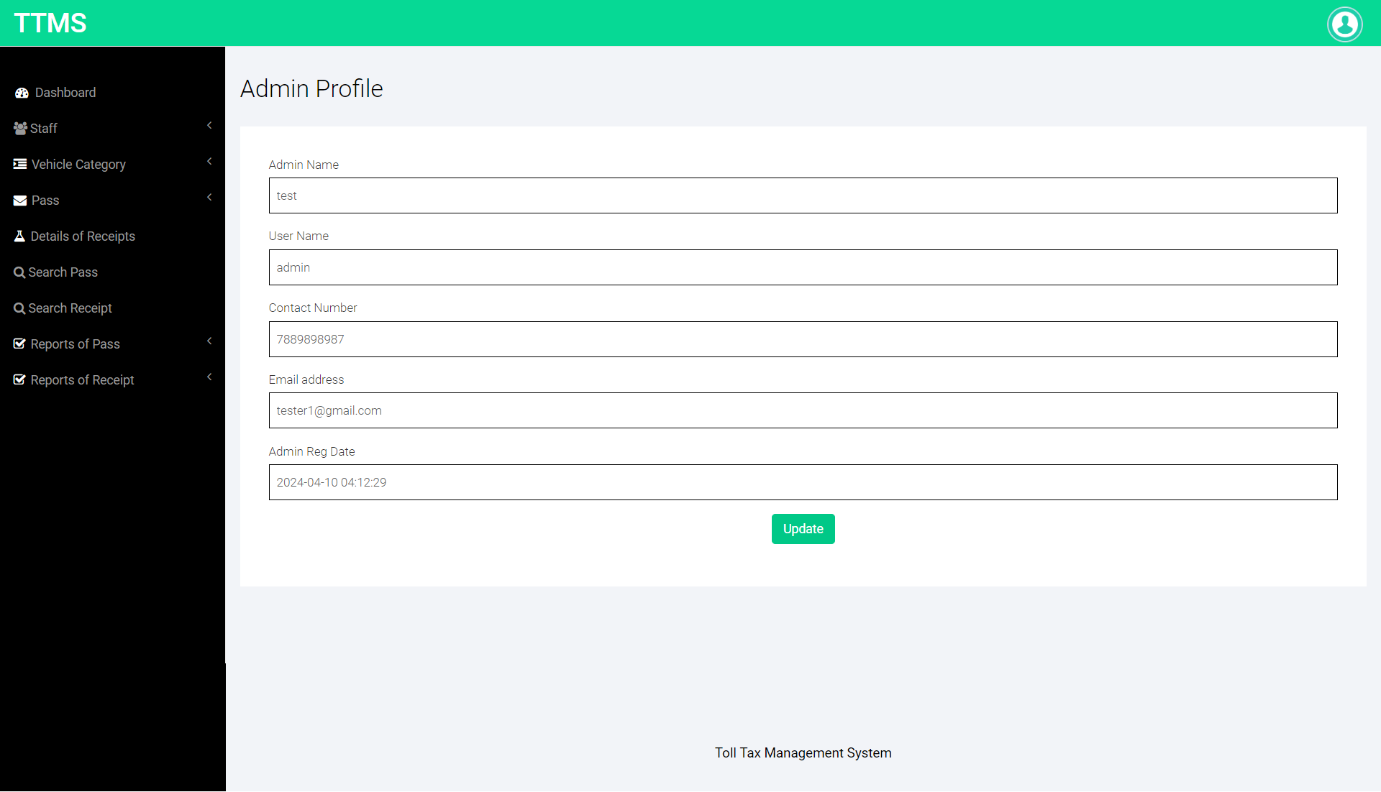
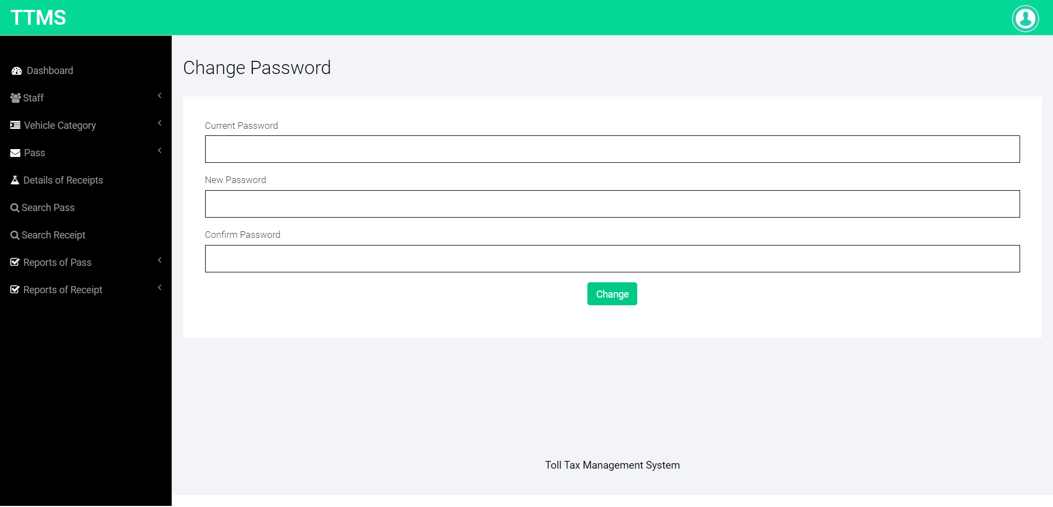

Slide 24
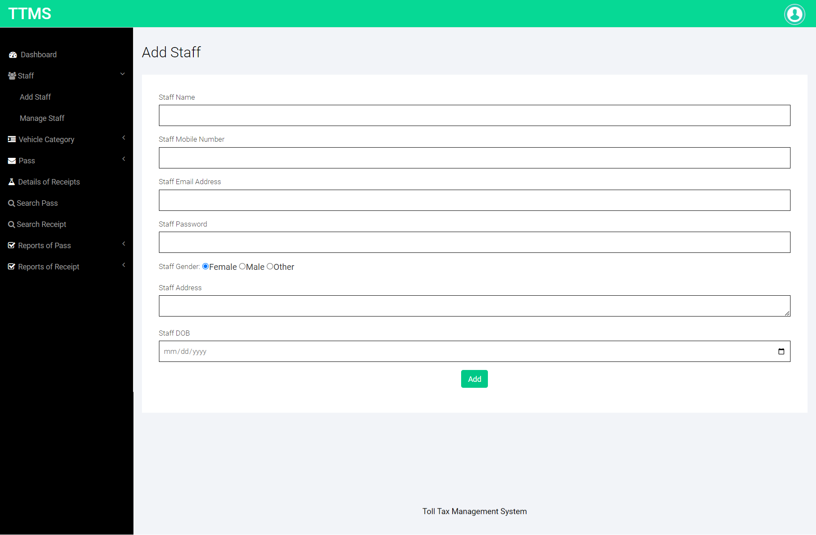
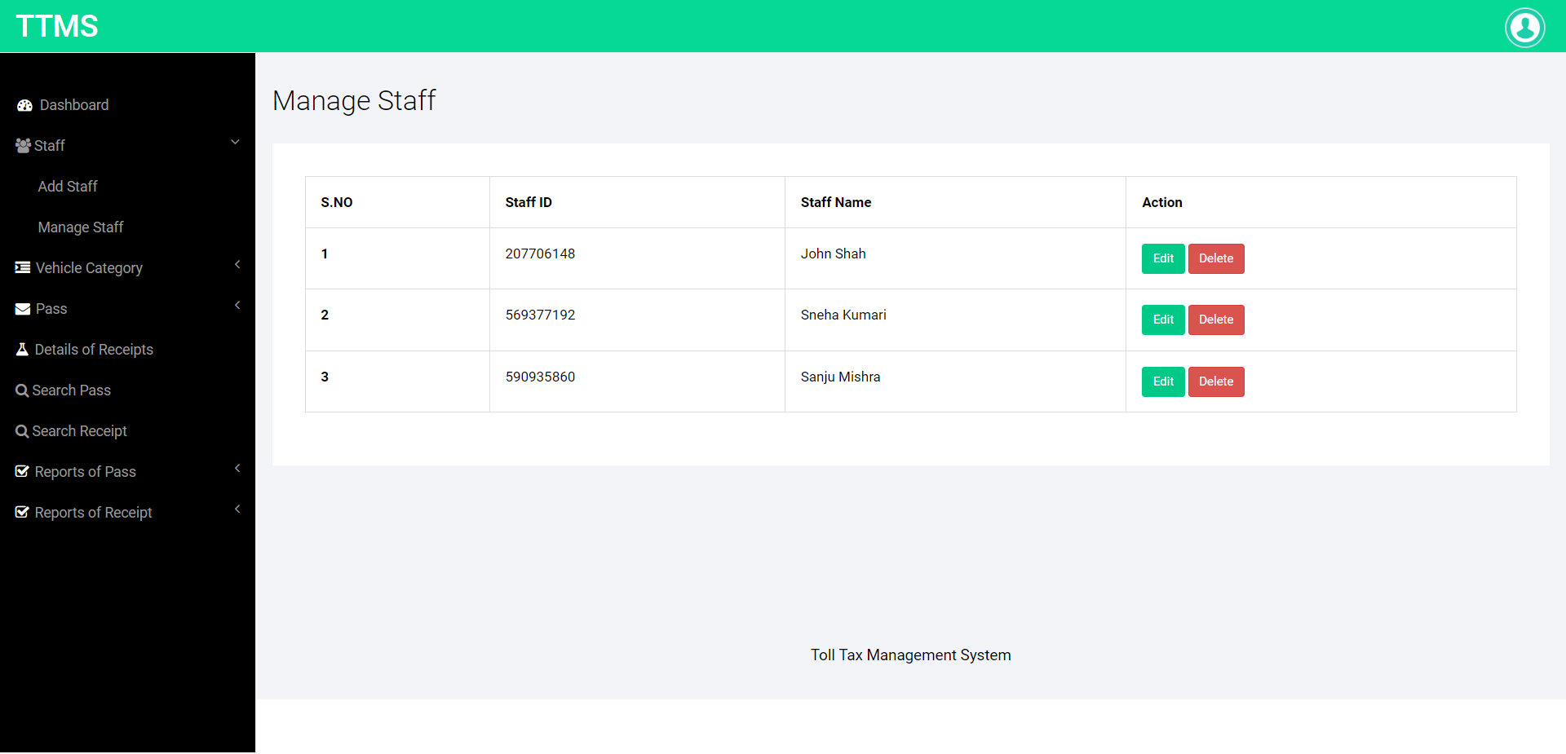

Slide 25

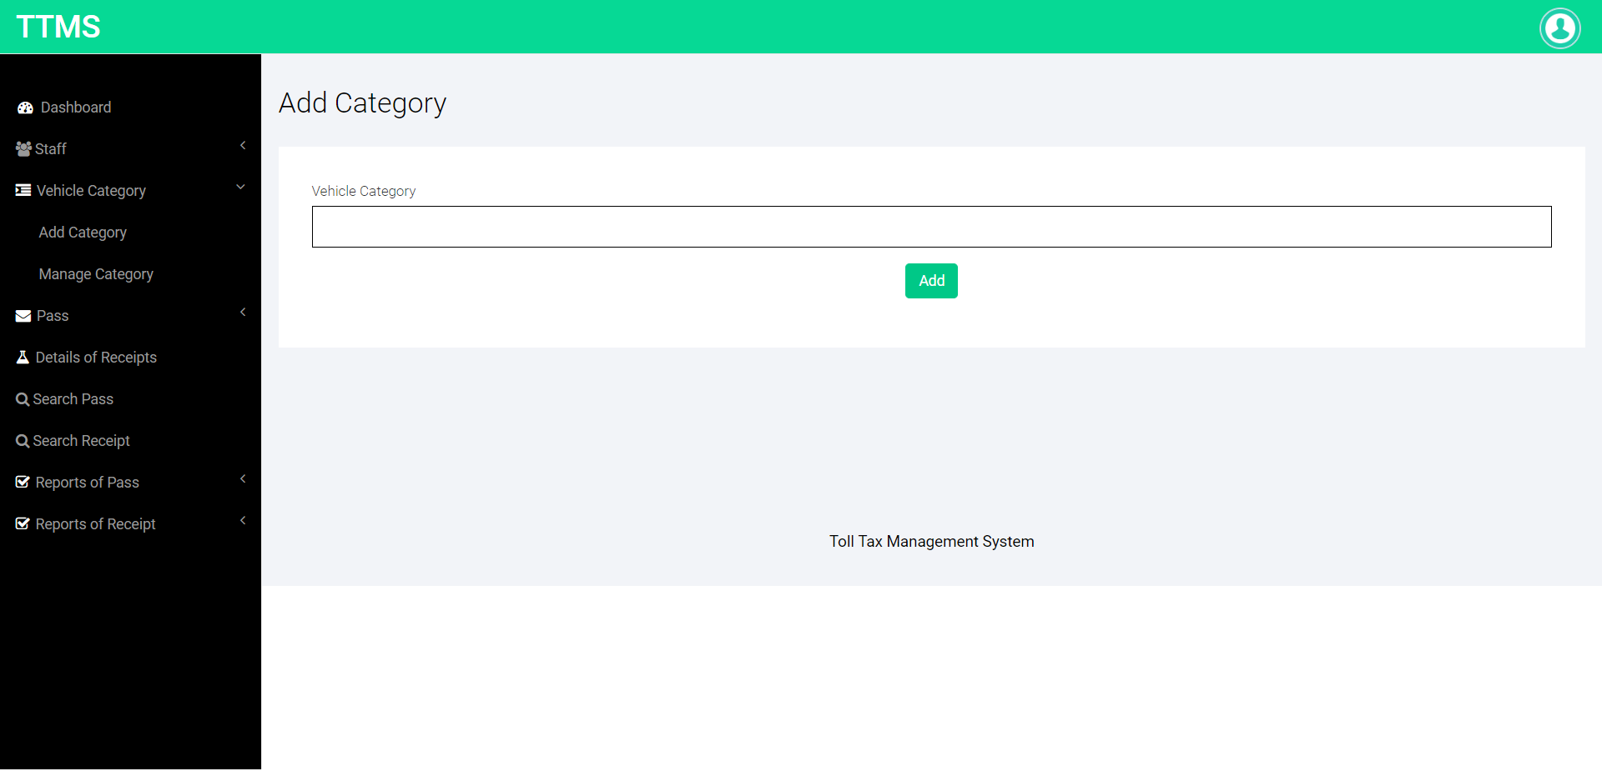

Slide 26
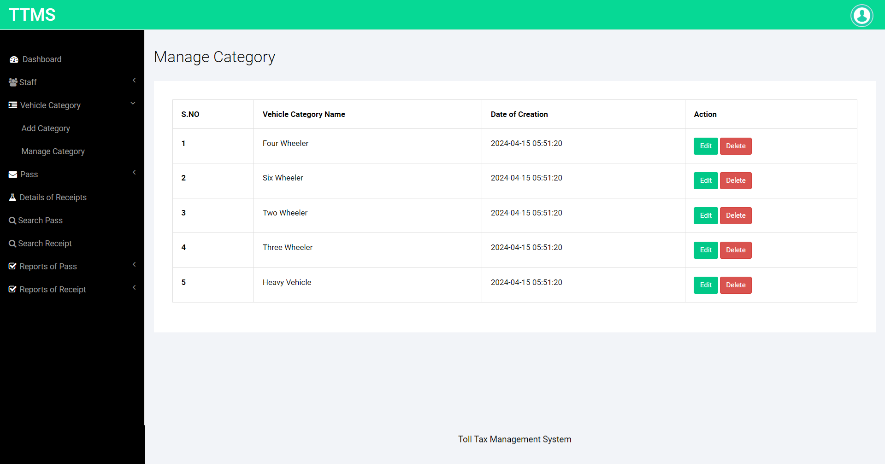


Slide 27
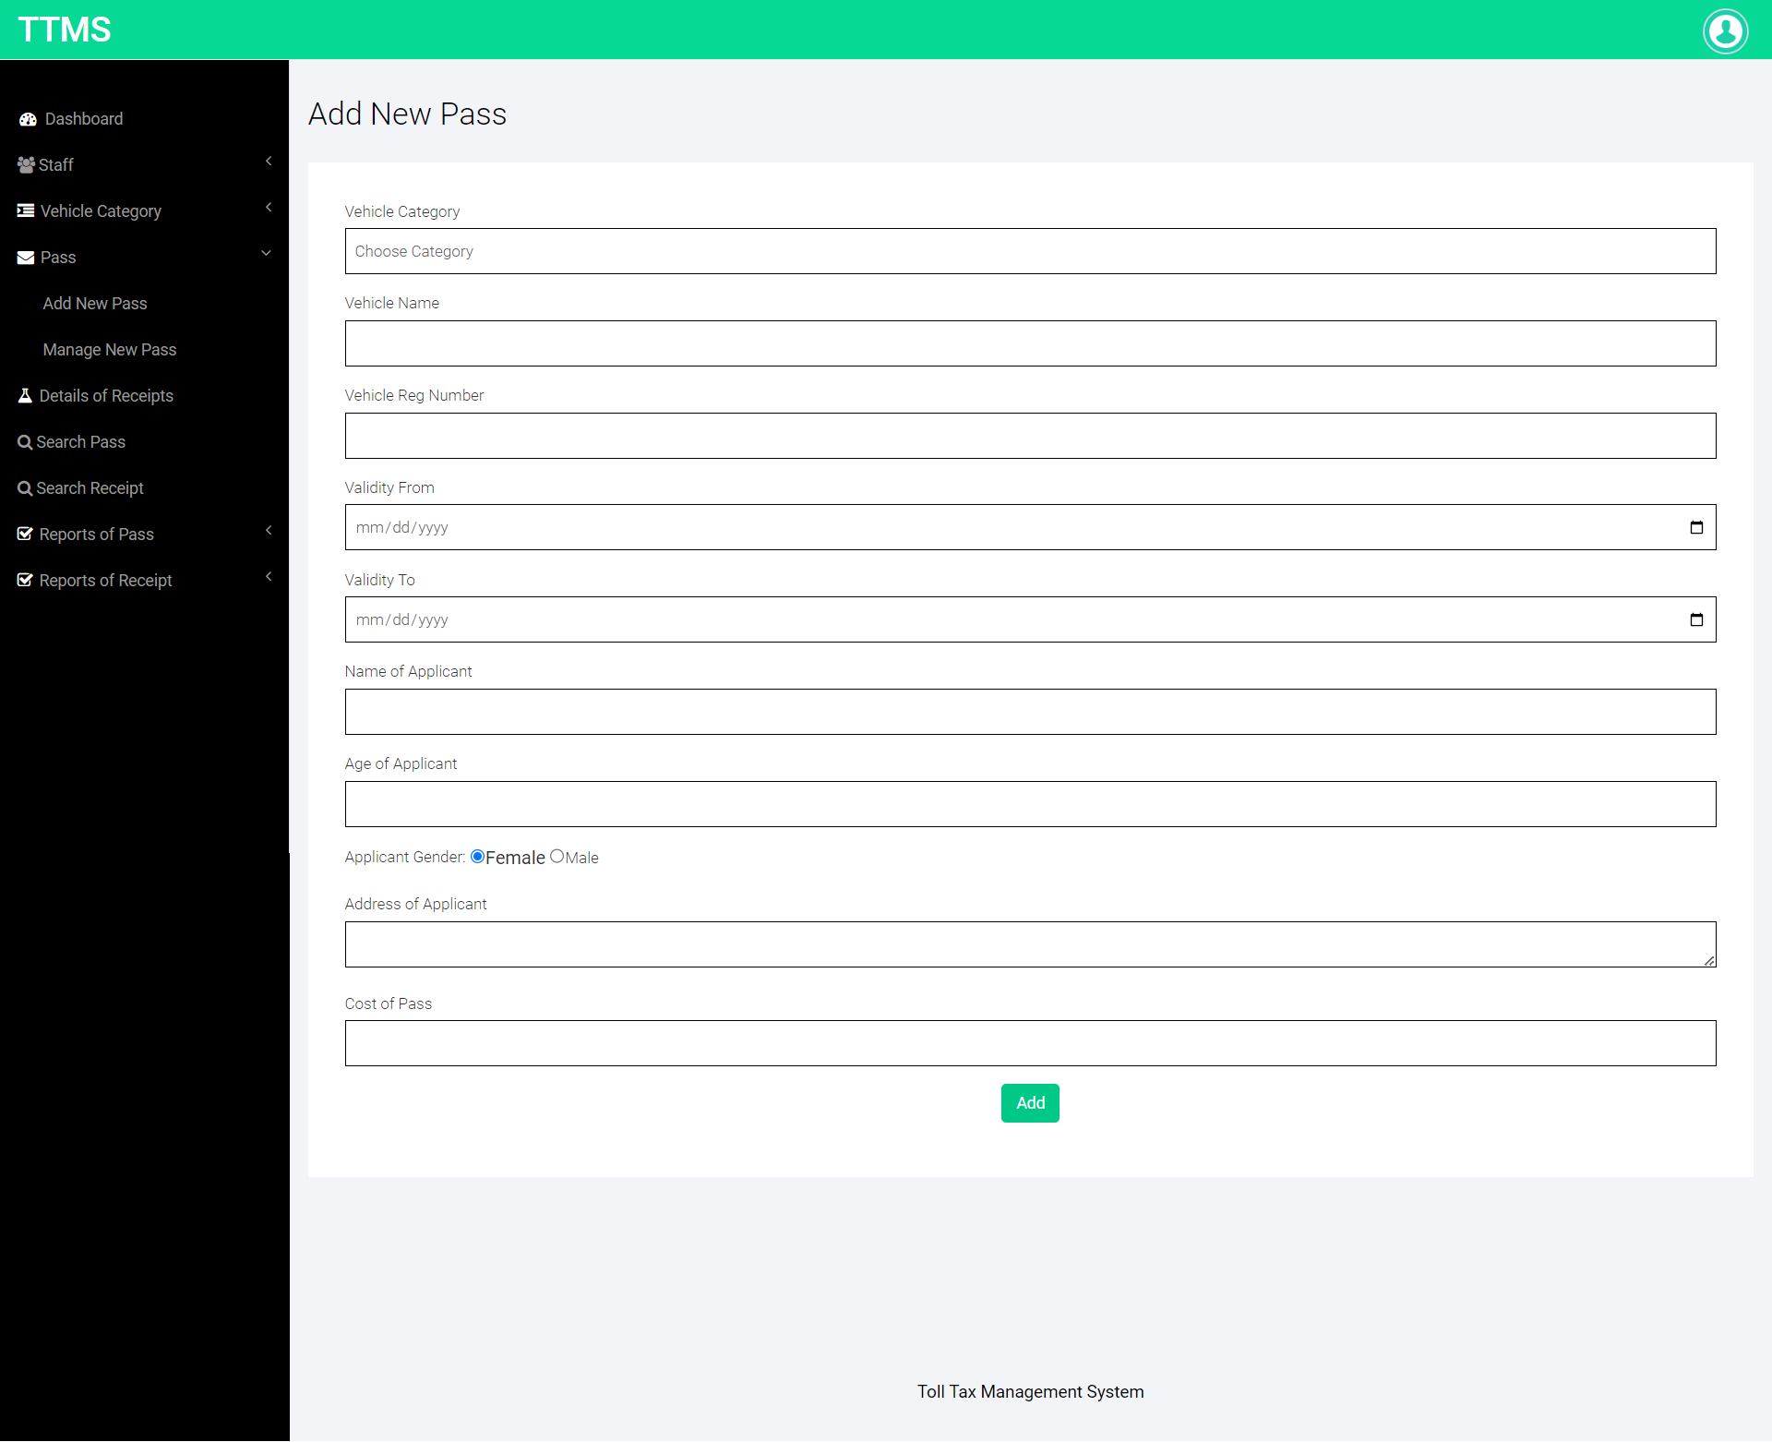

Slide 28
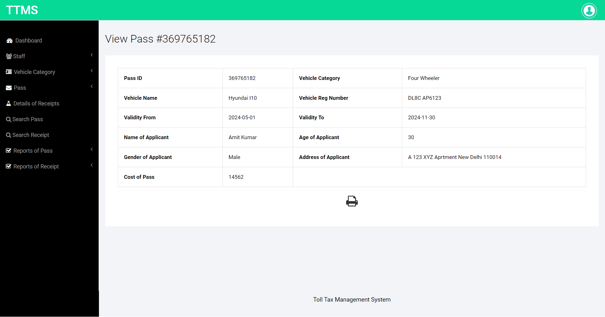
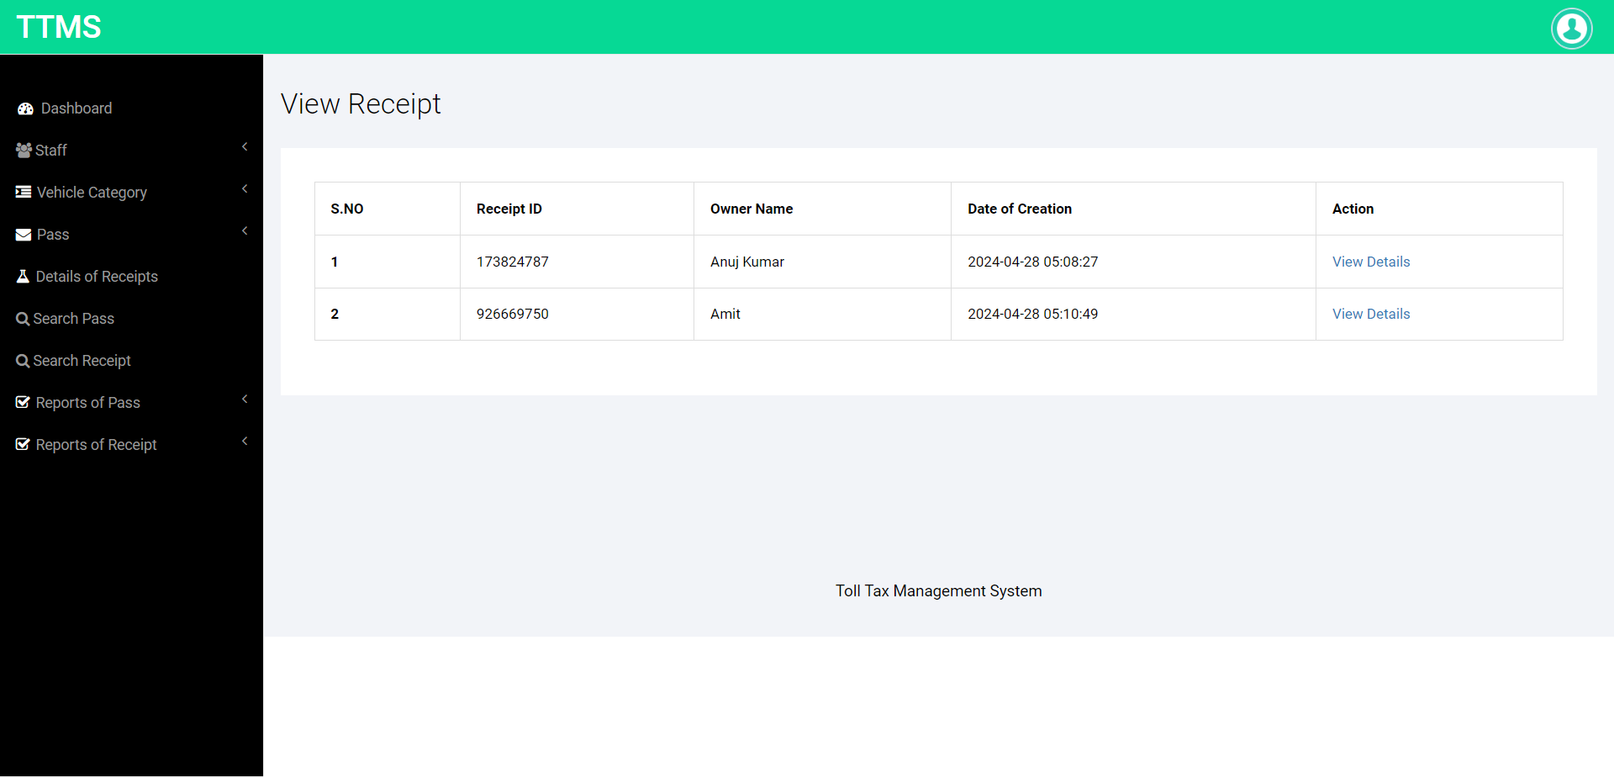

Slide 29
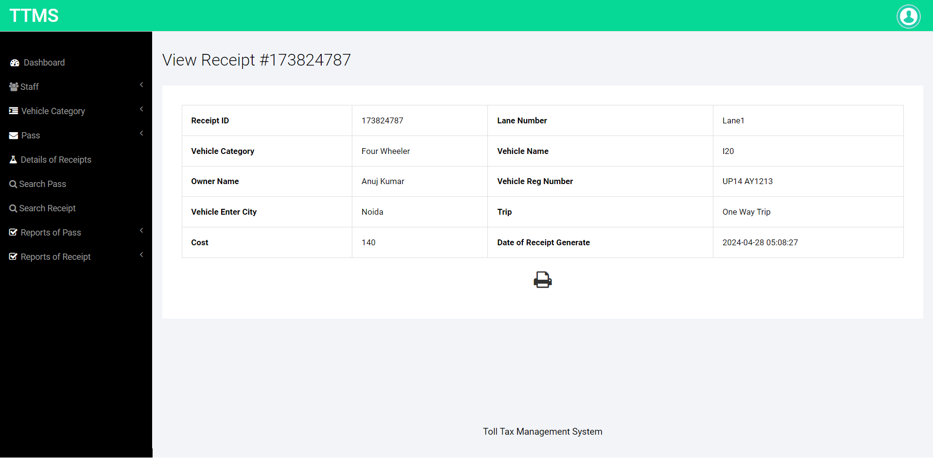
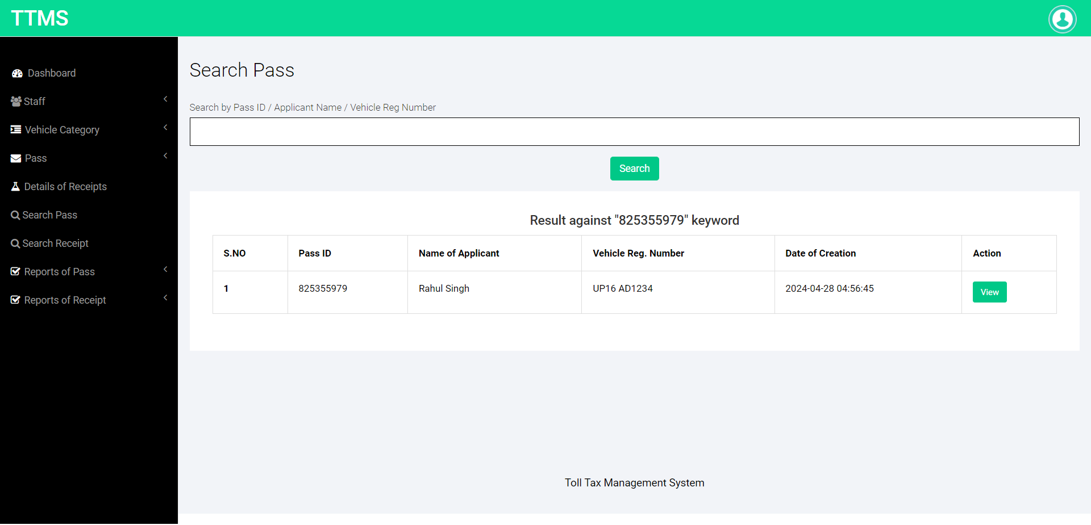

Slide 30
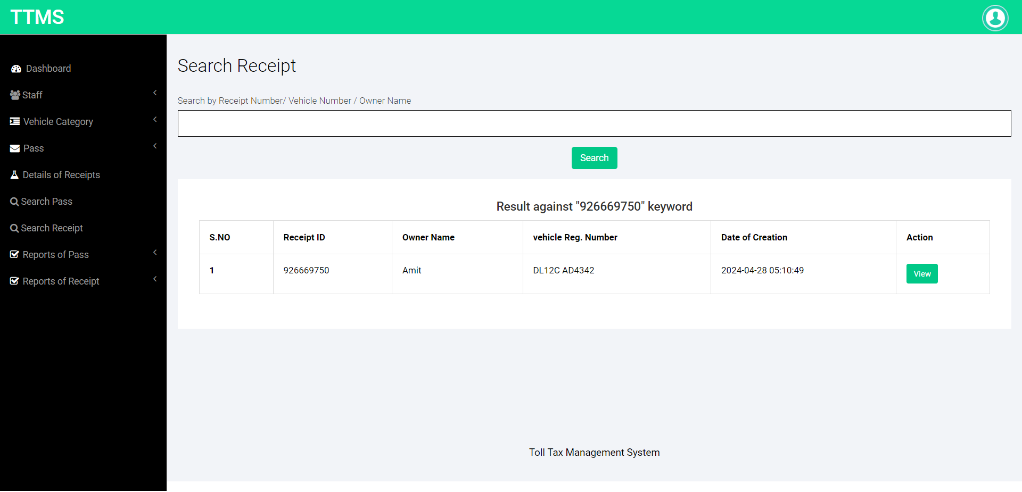
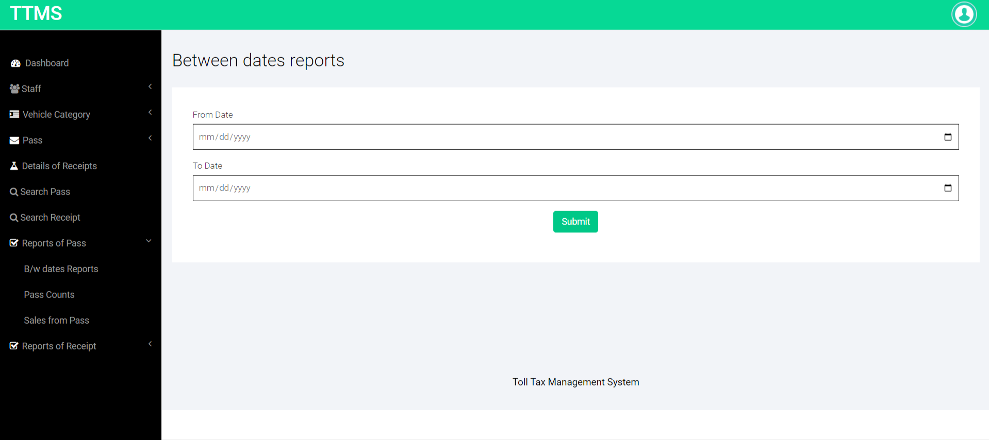

Slide 31
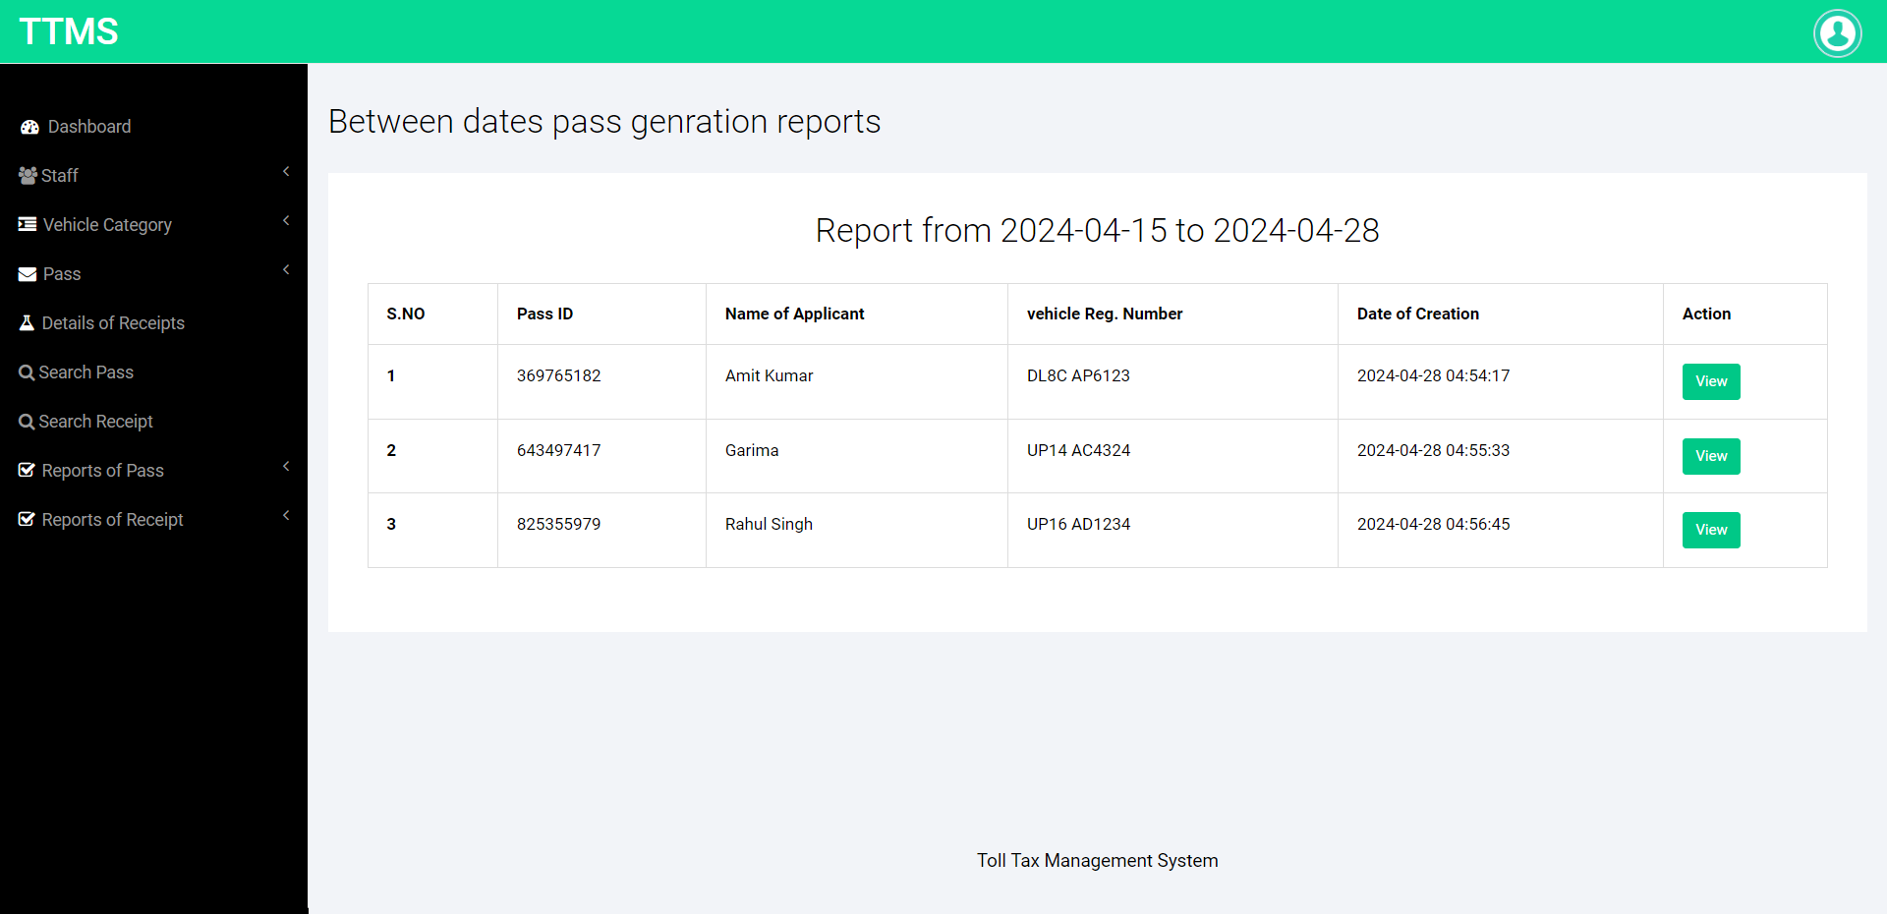


Slide 32
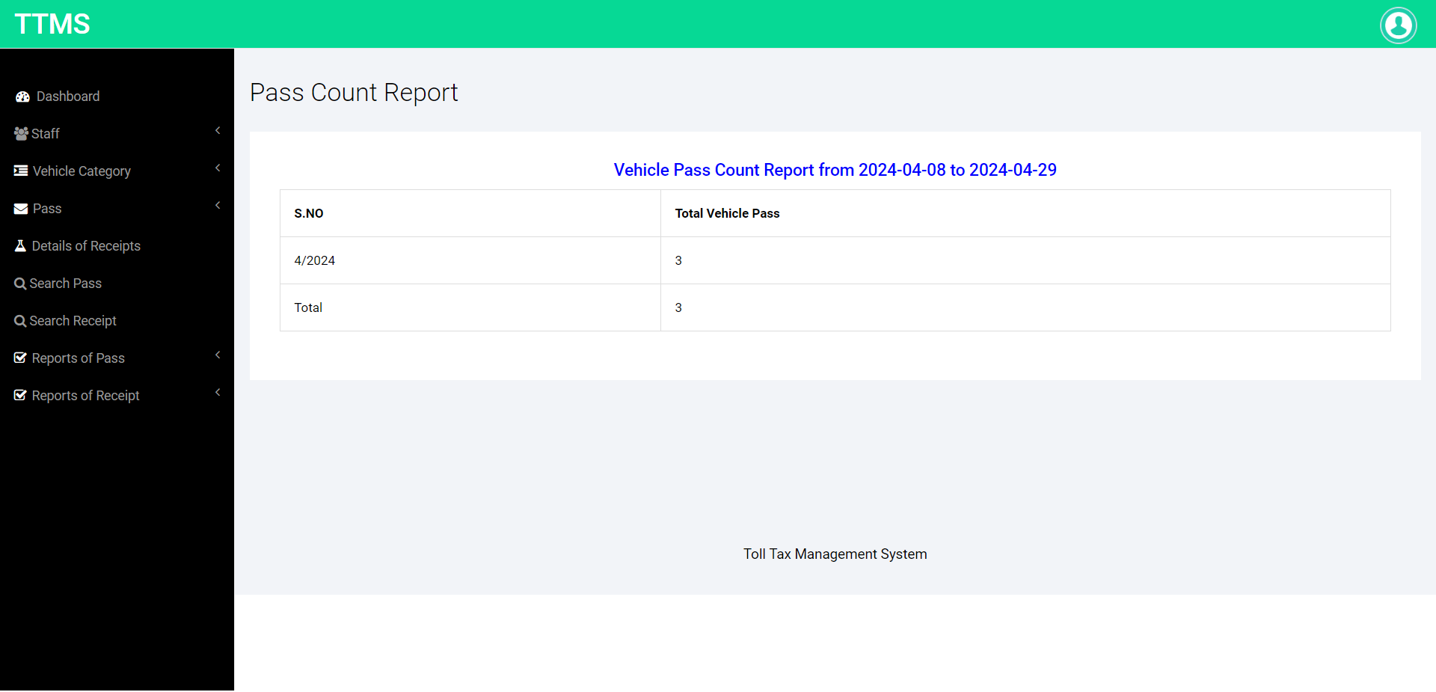
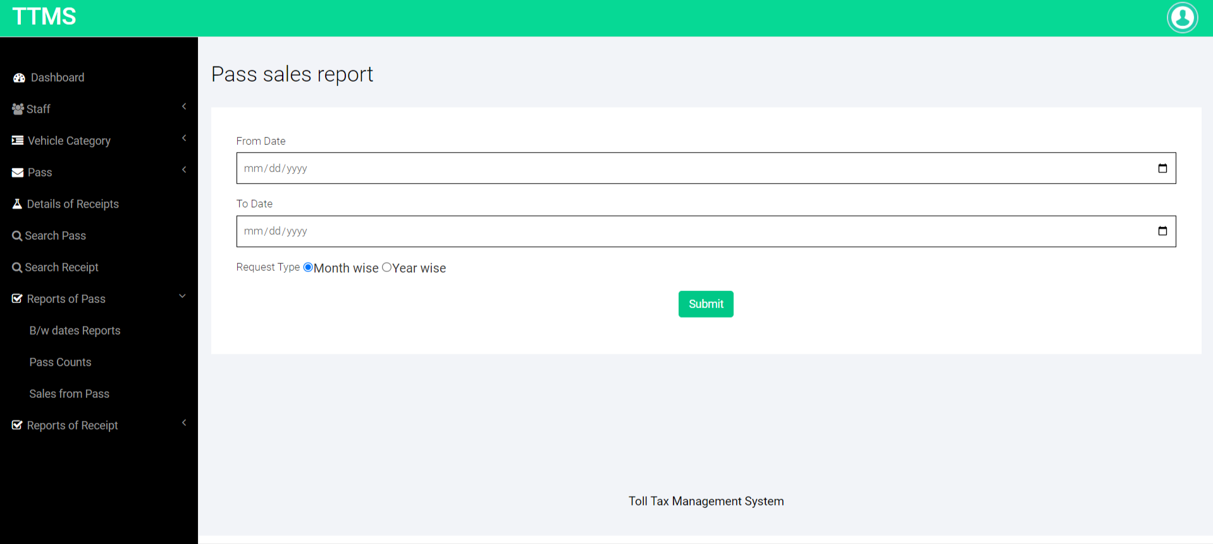

Slide 33
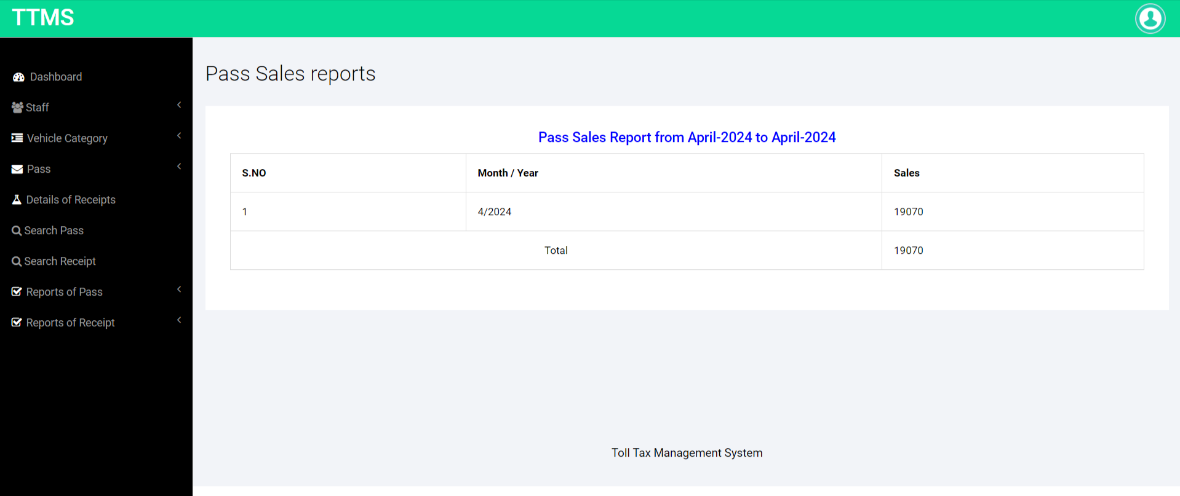


Slide 34
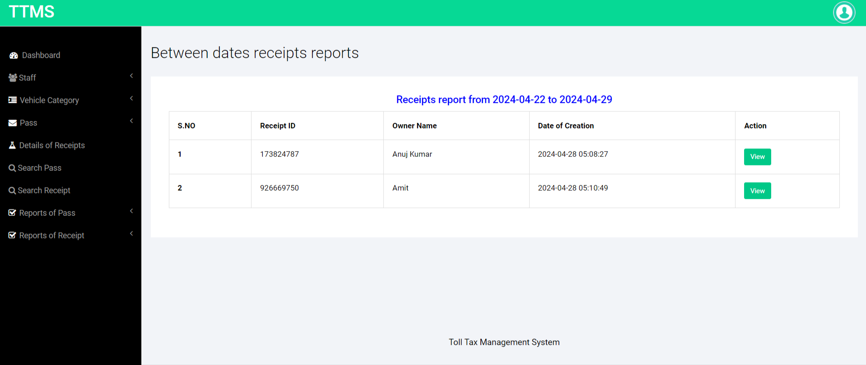


Slide 35
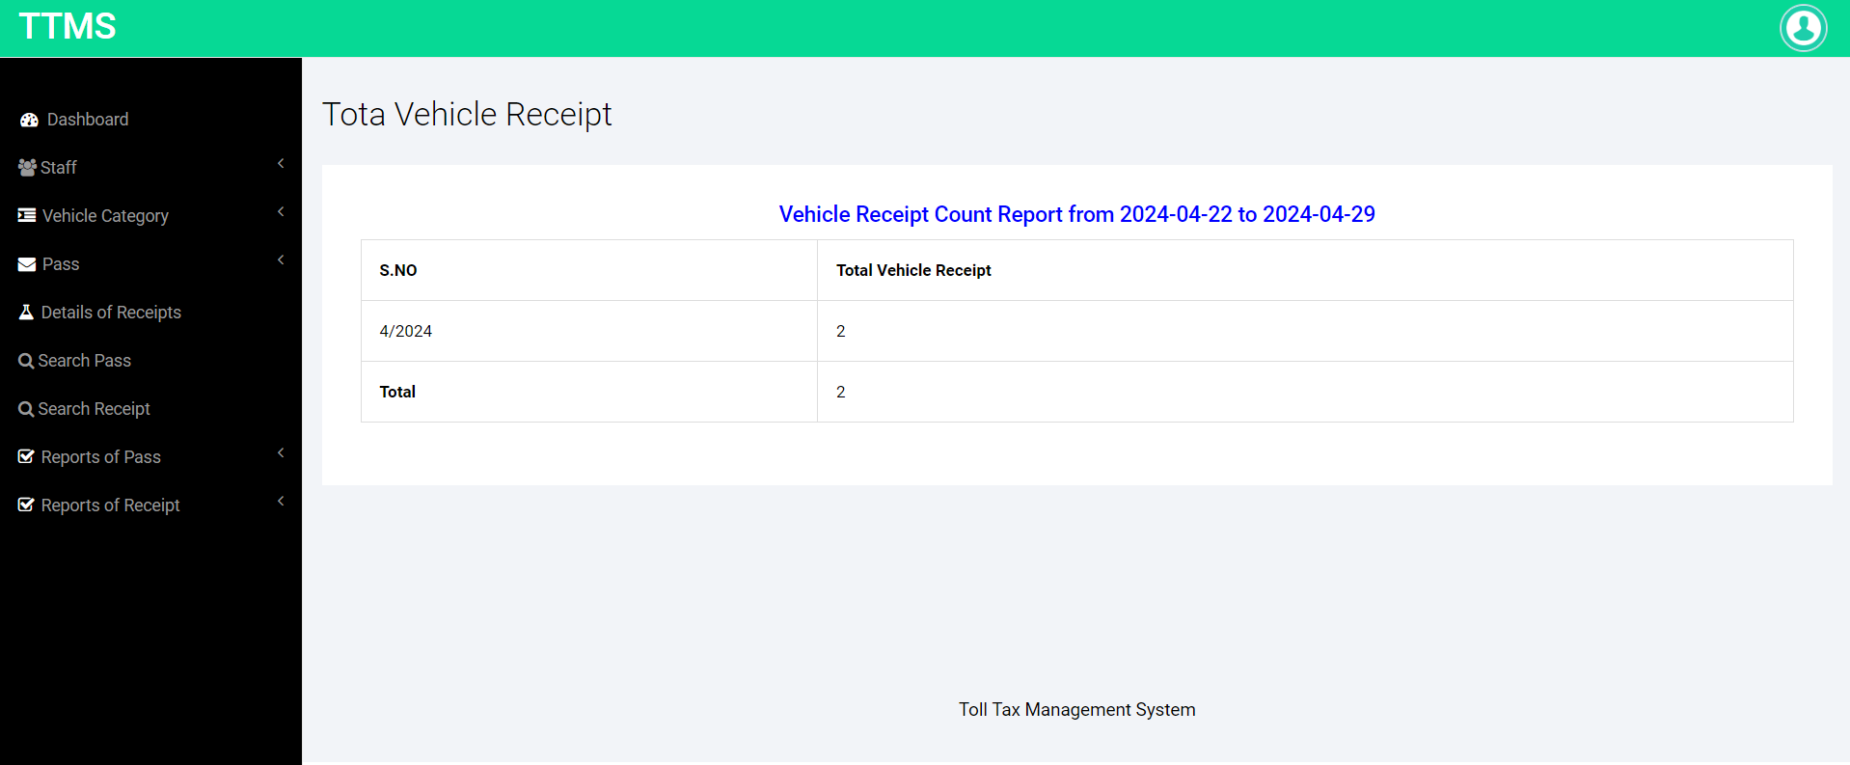
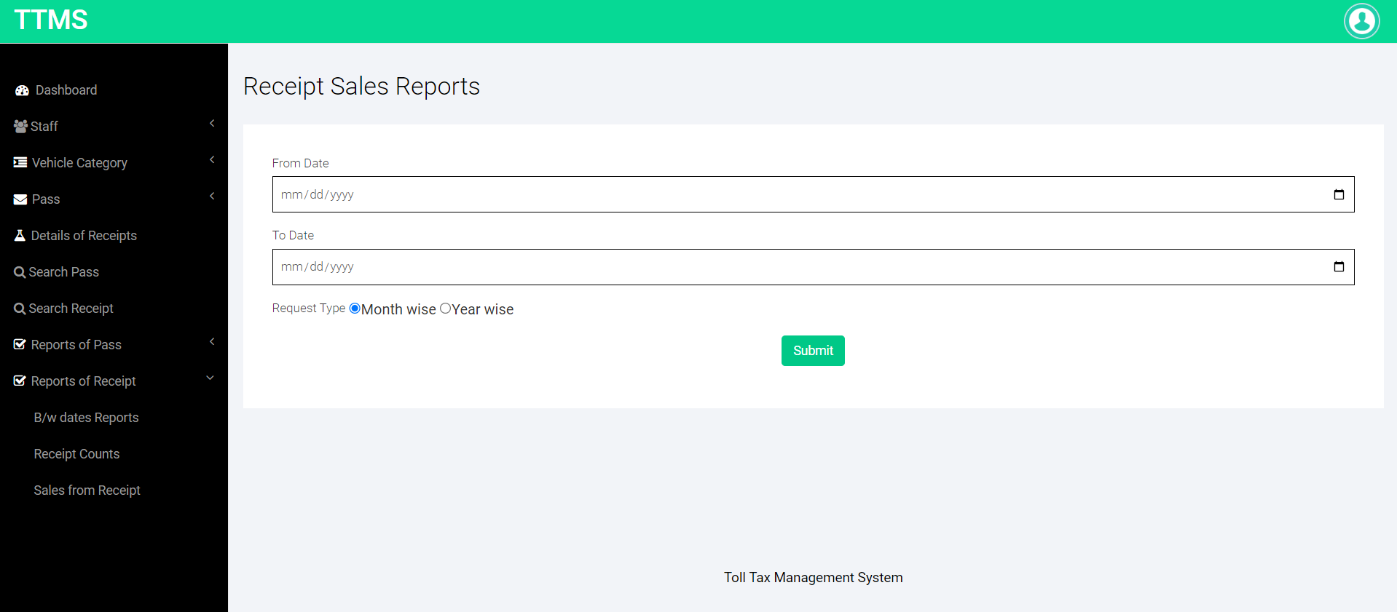

Slide 36
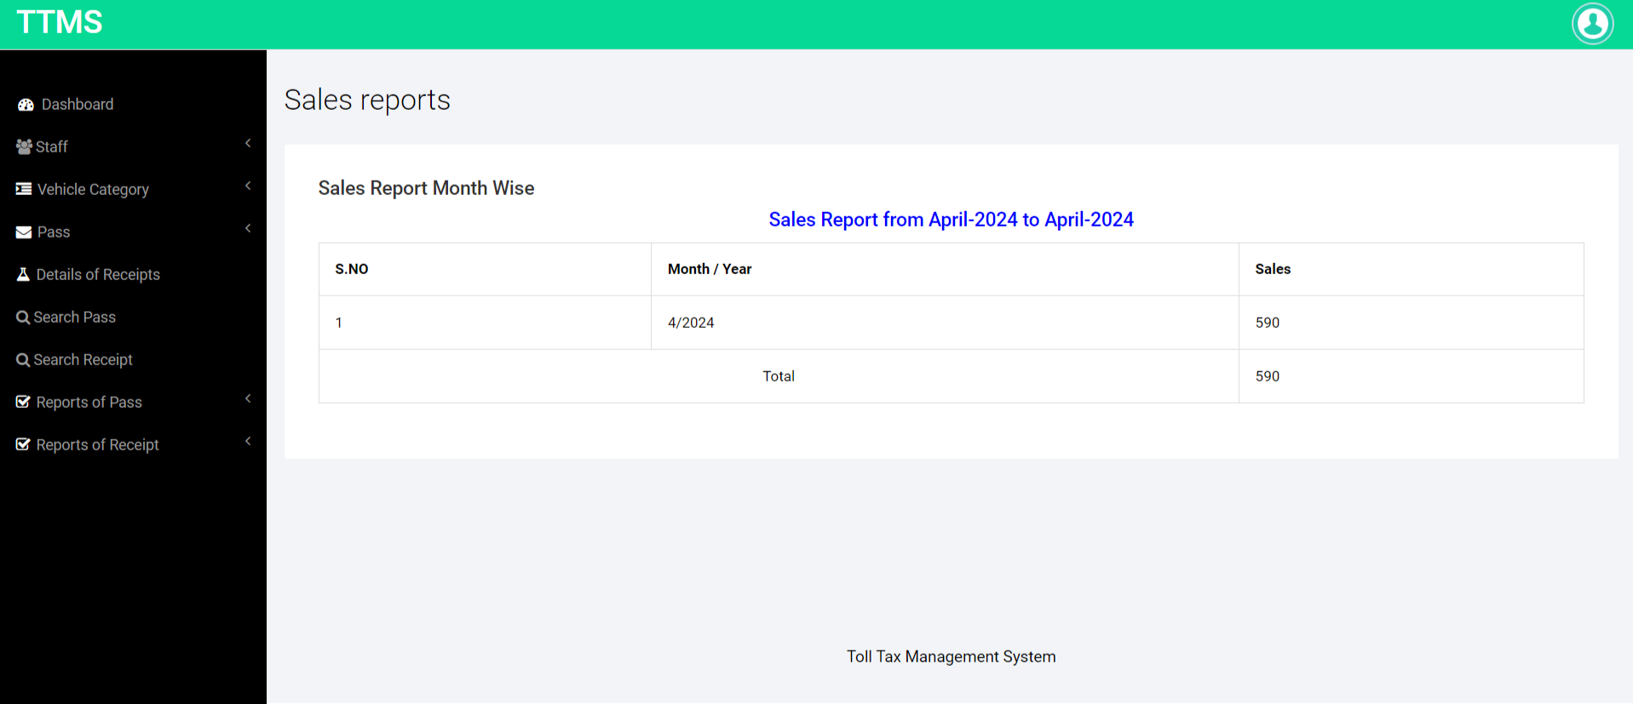
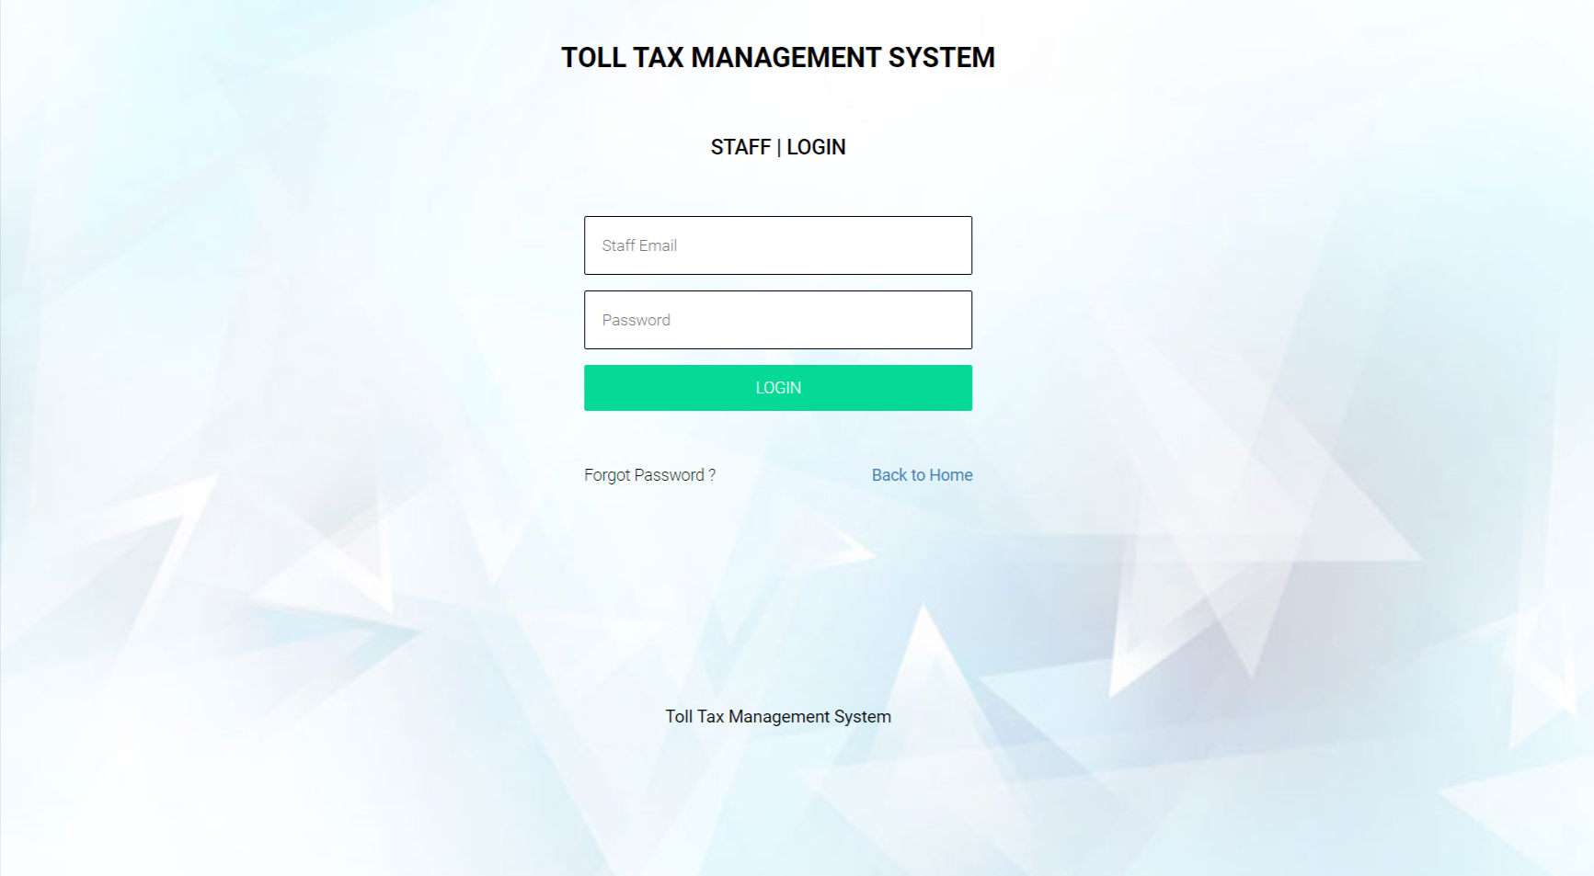

Slide 37
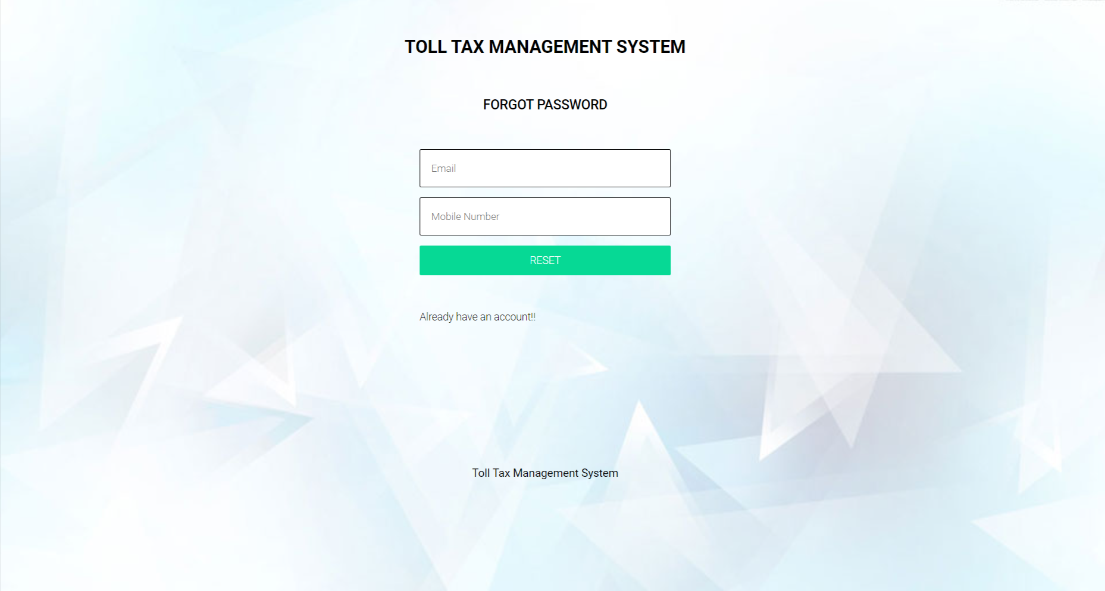
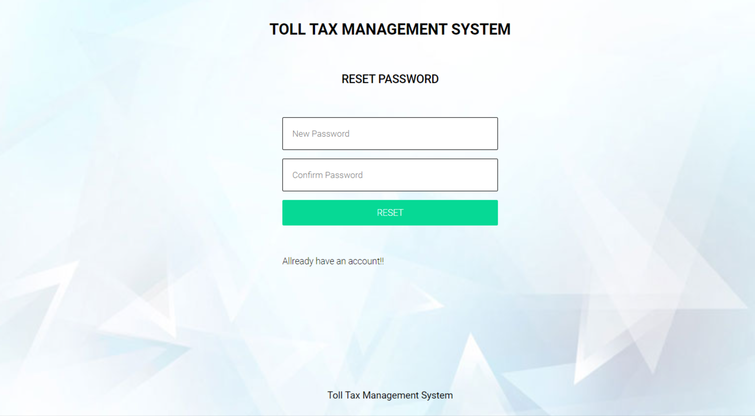

Slide 38
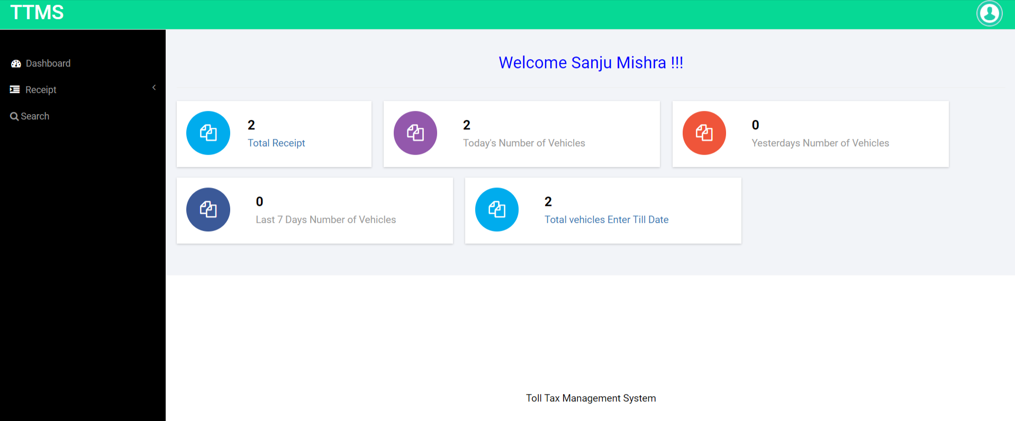
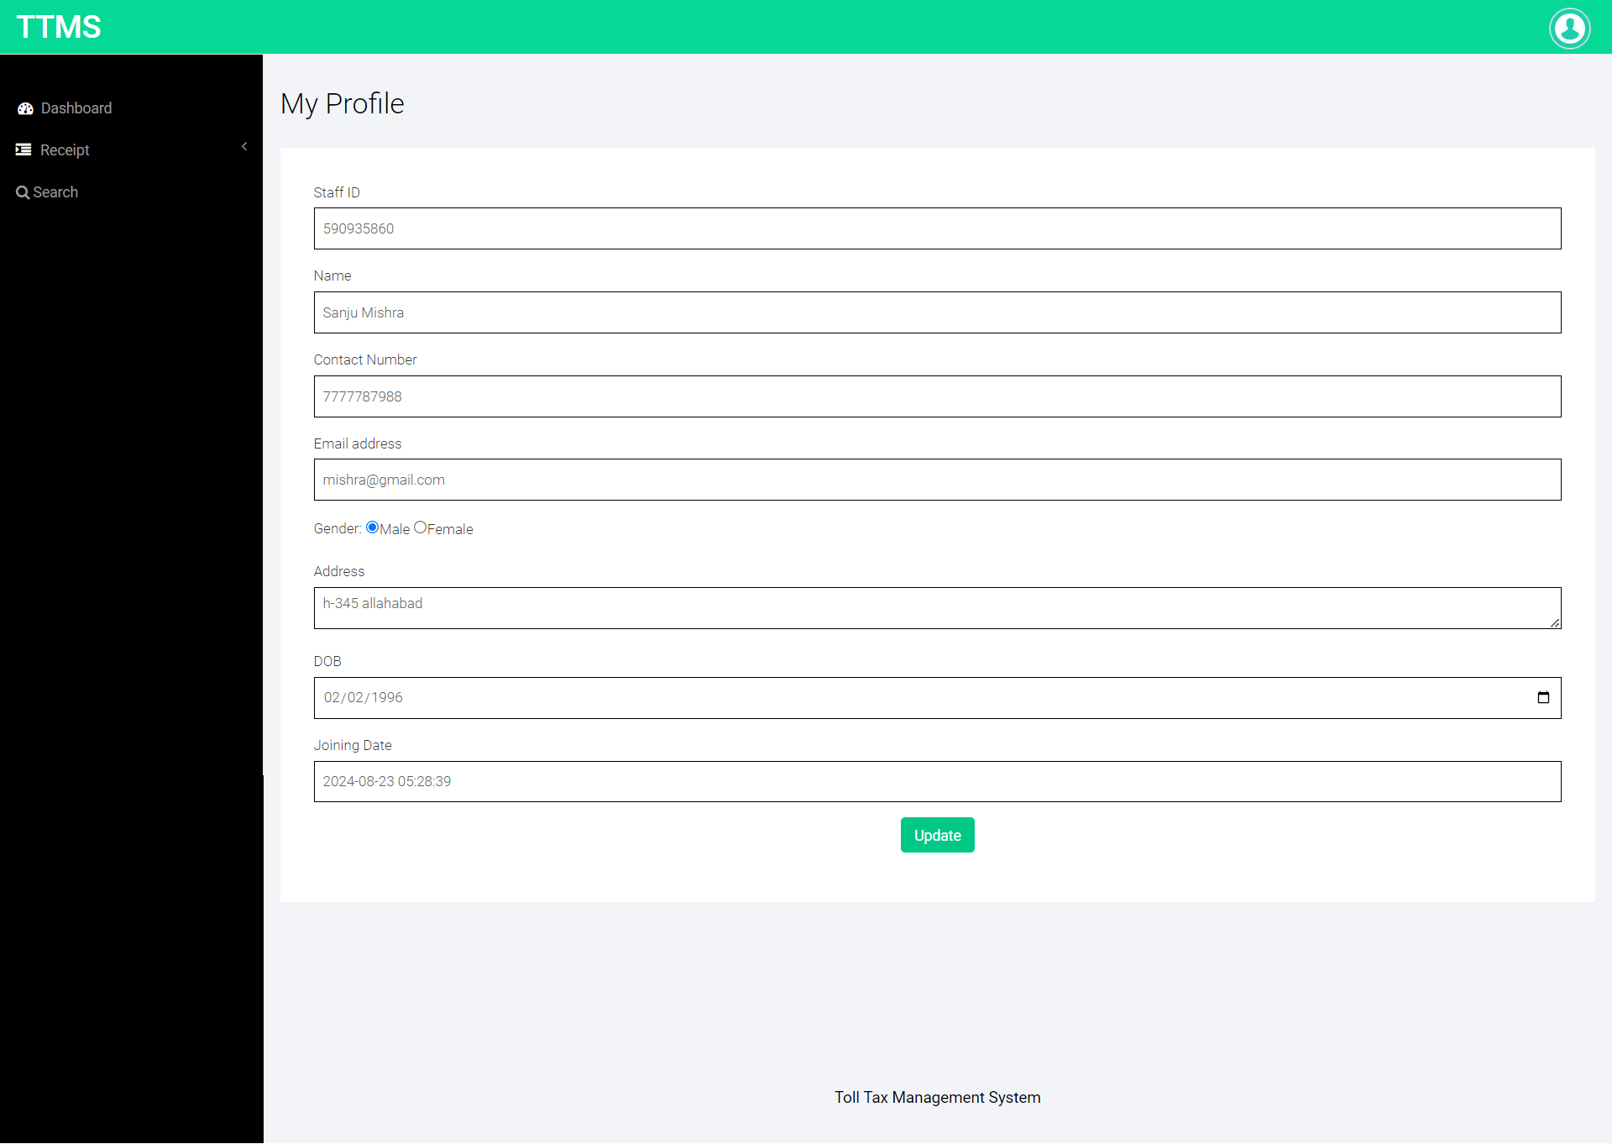

Slide 39
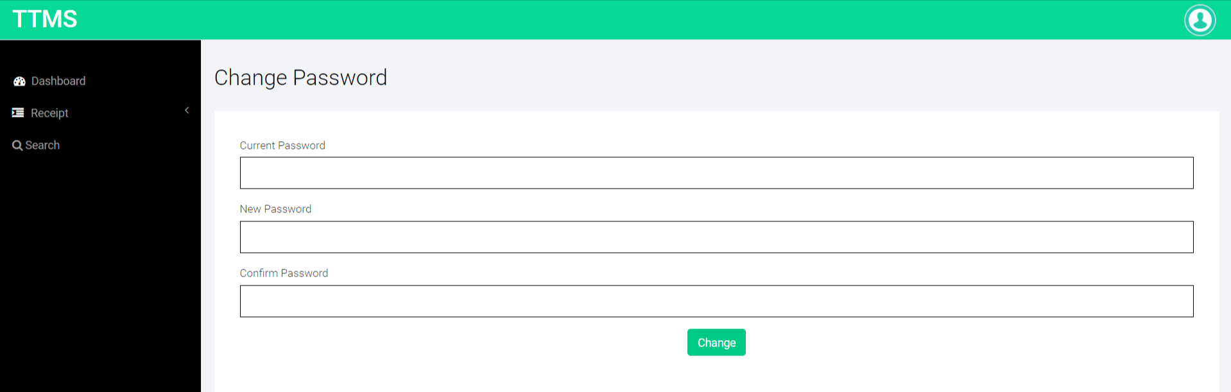
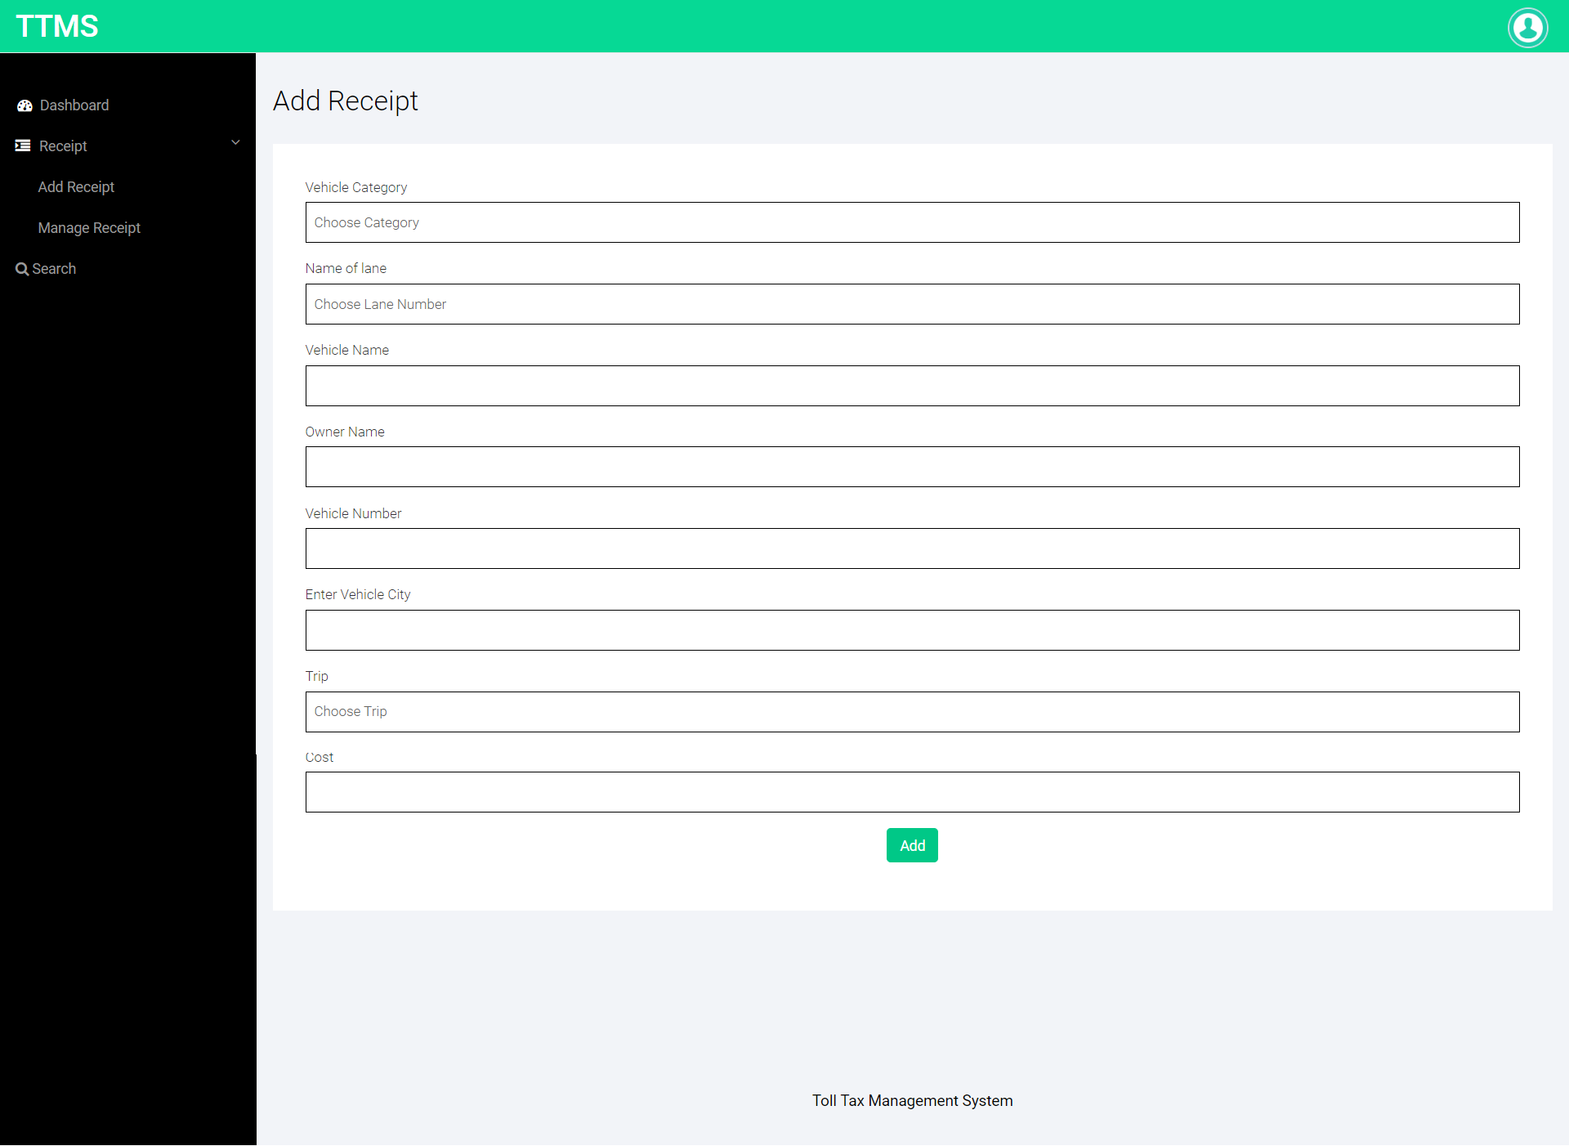

Slide 40
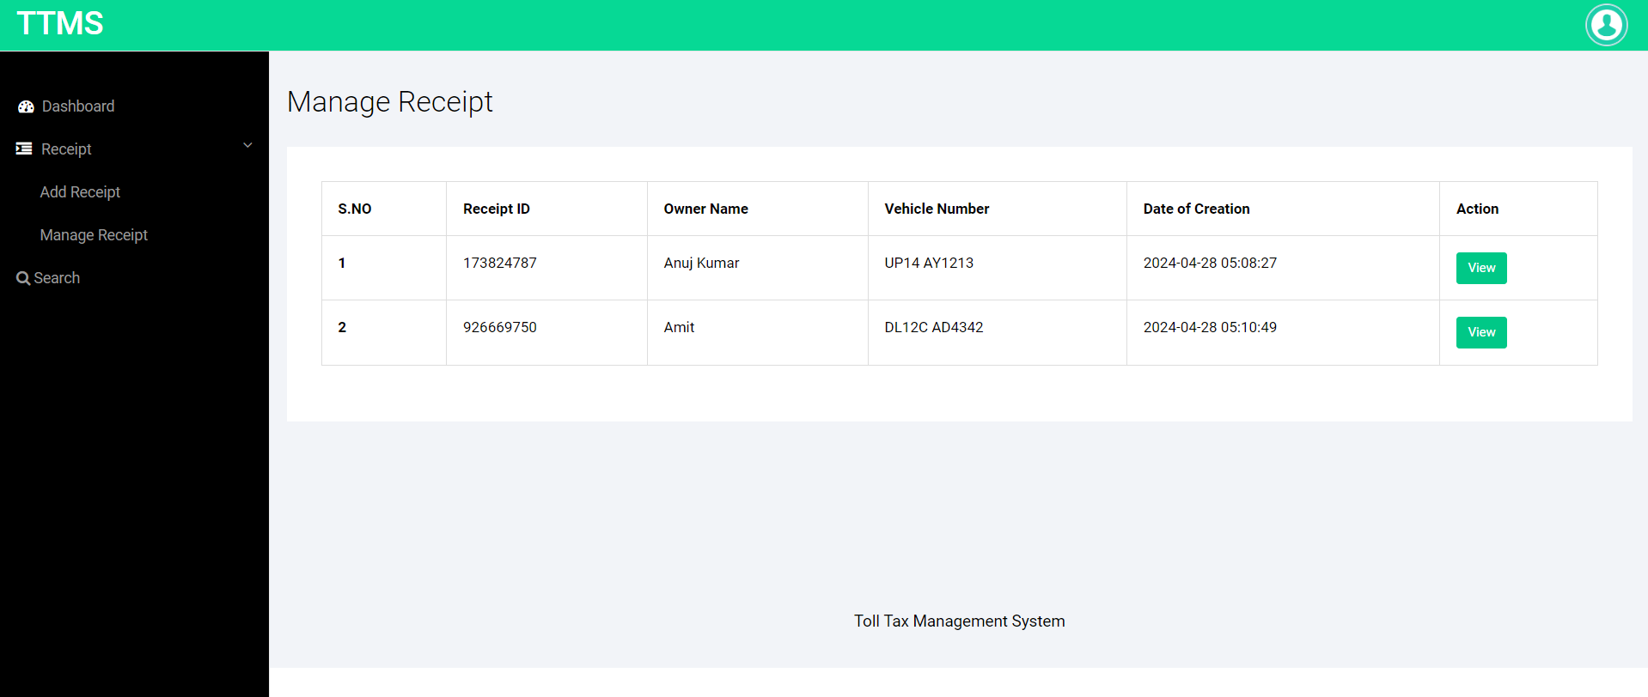
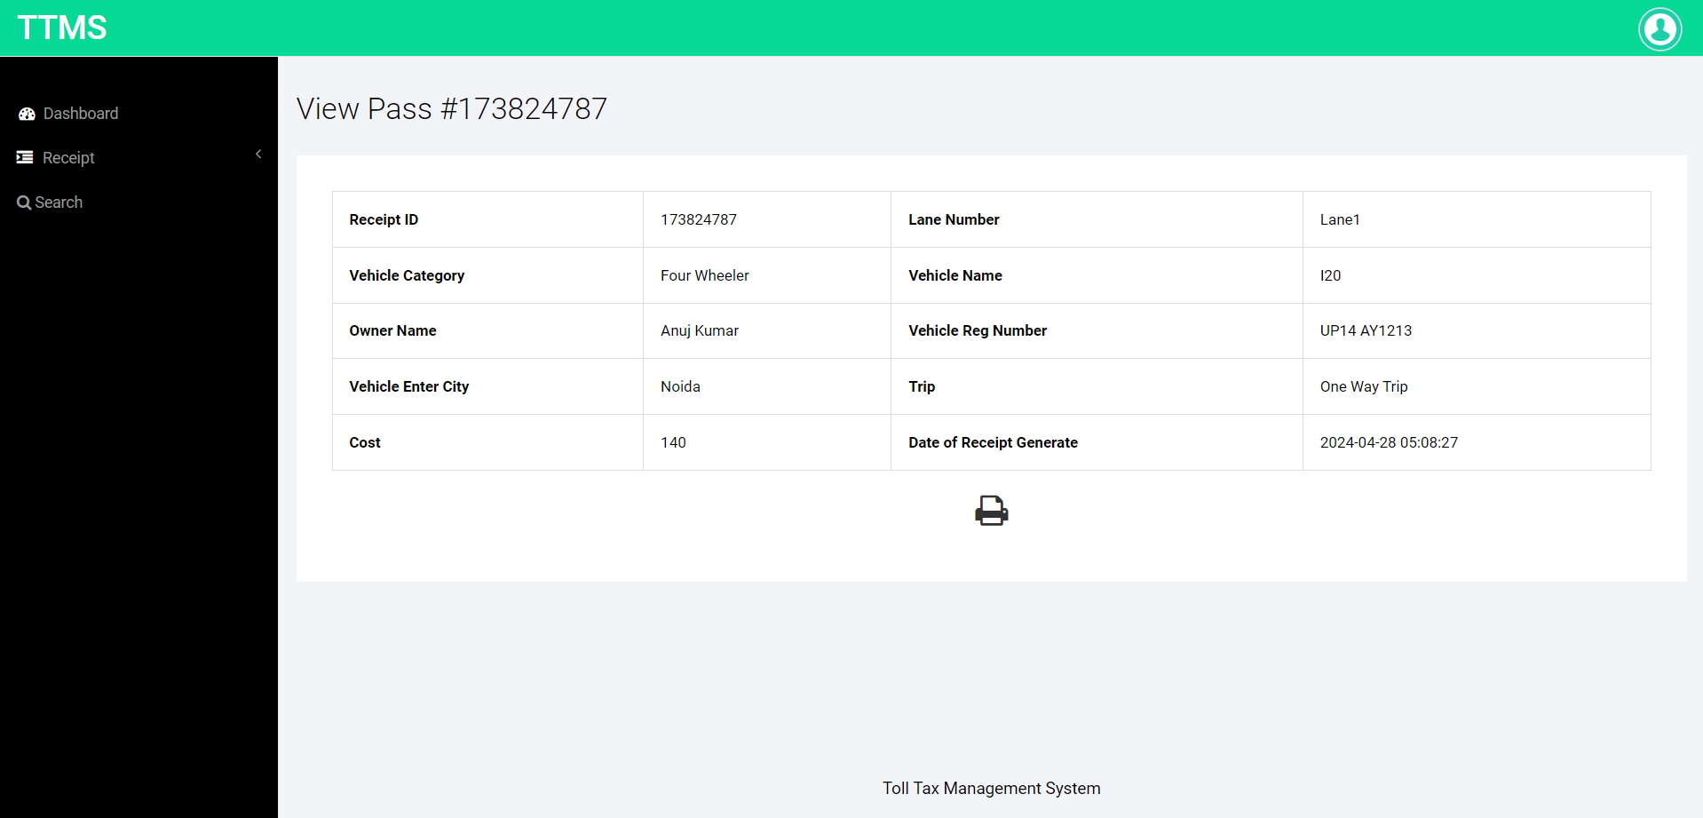

Slide 41
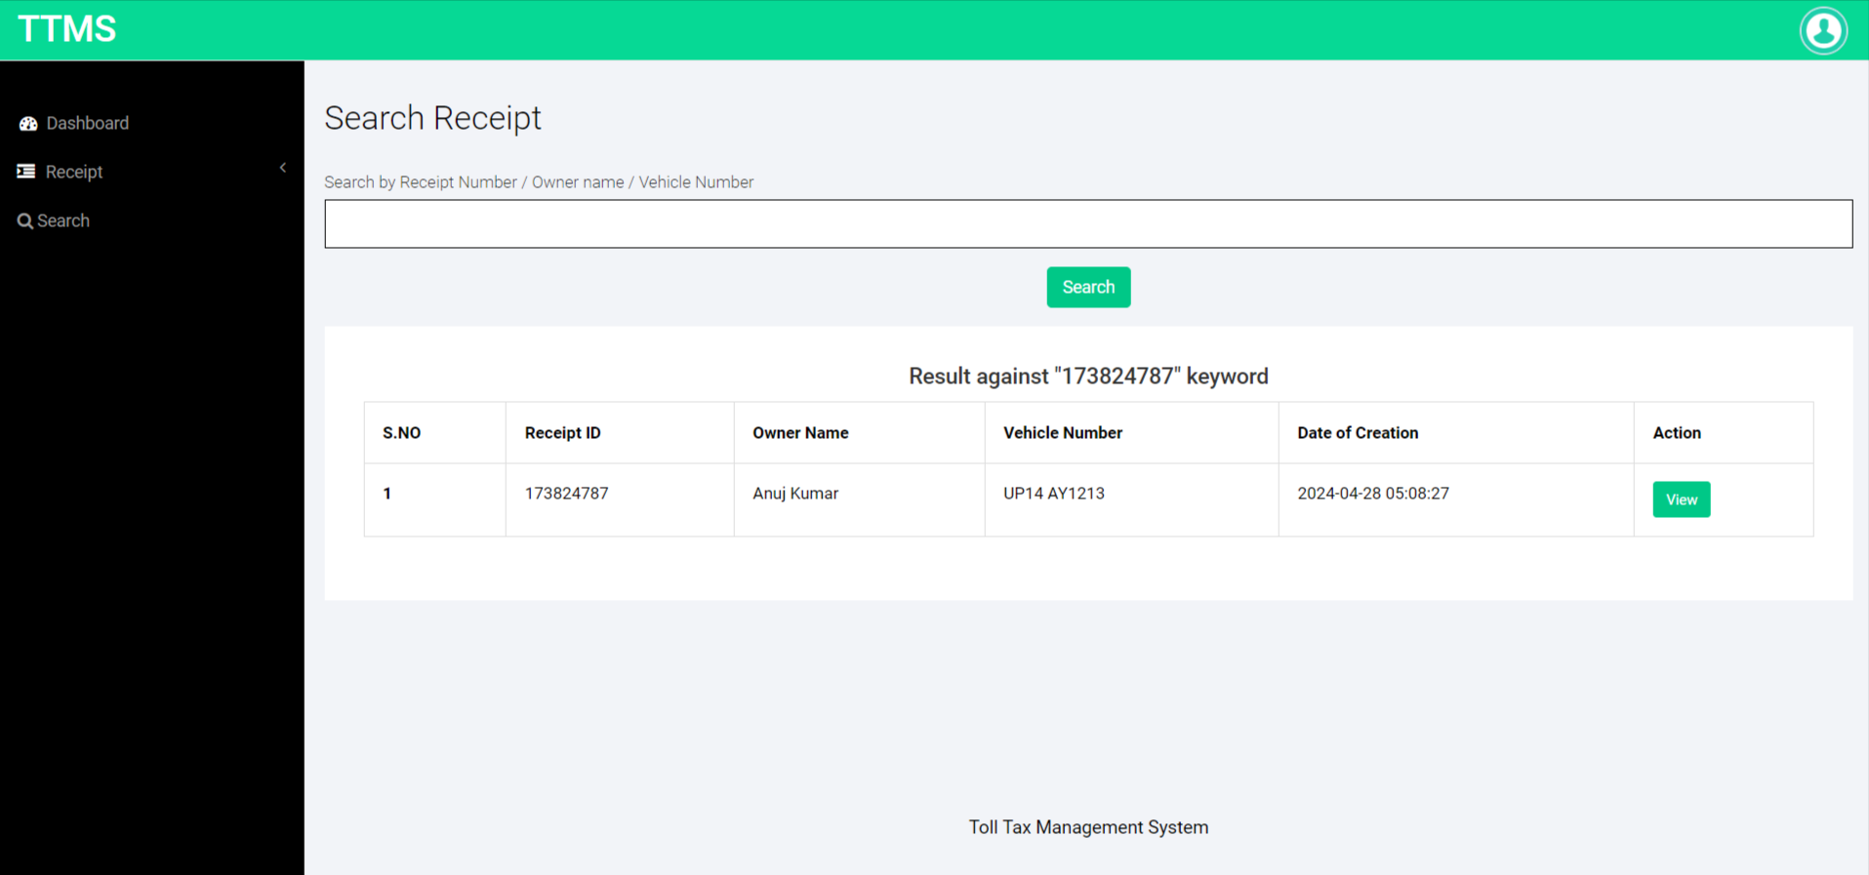

Slide 42
Conclusion
The project titled as Toll Tax Management System was deeply studied and analyzed to design the code and implement. It was done under the guidance of the experienced project guide. All the current requirements and possibilities have been taken care during the project time.
Toll Tax management system is used for daily operations in any organization to maintain or access toll related information for internal administration purposes.

Slide 43
References
For PHP
https://www.w3schools.com/php/default.asp
https://www.sitepoint.com/php/
https://www.php.net/
For MySQL
https://www.mysql.com/
http://www.mysqltutorial.org
For XAMPP
https://www.apachefriends.org/download.html

Slide 44
Thank You

